Slide 1
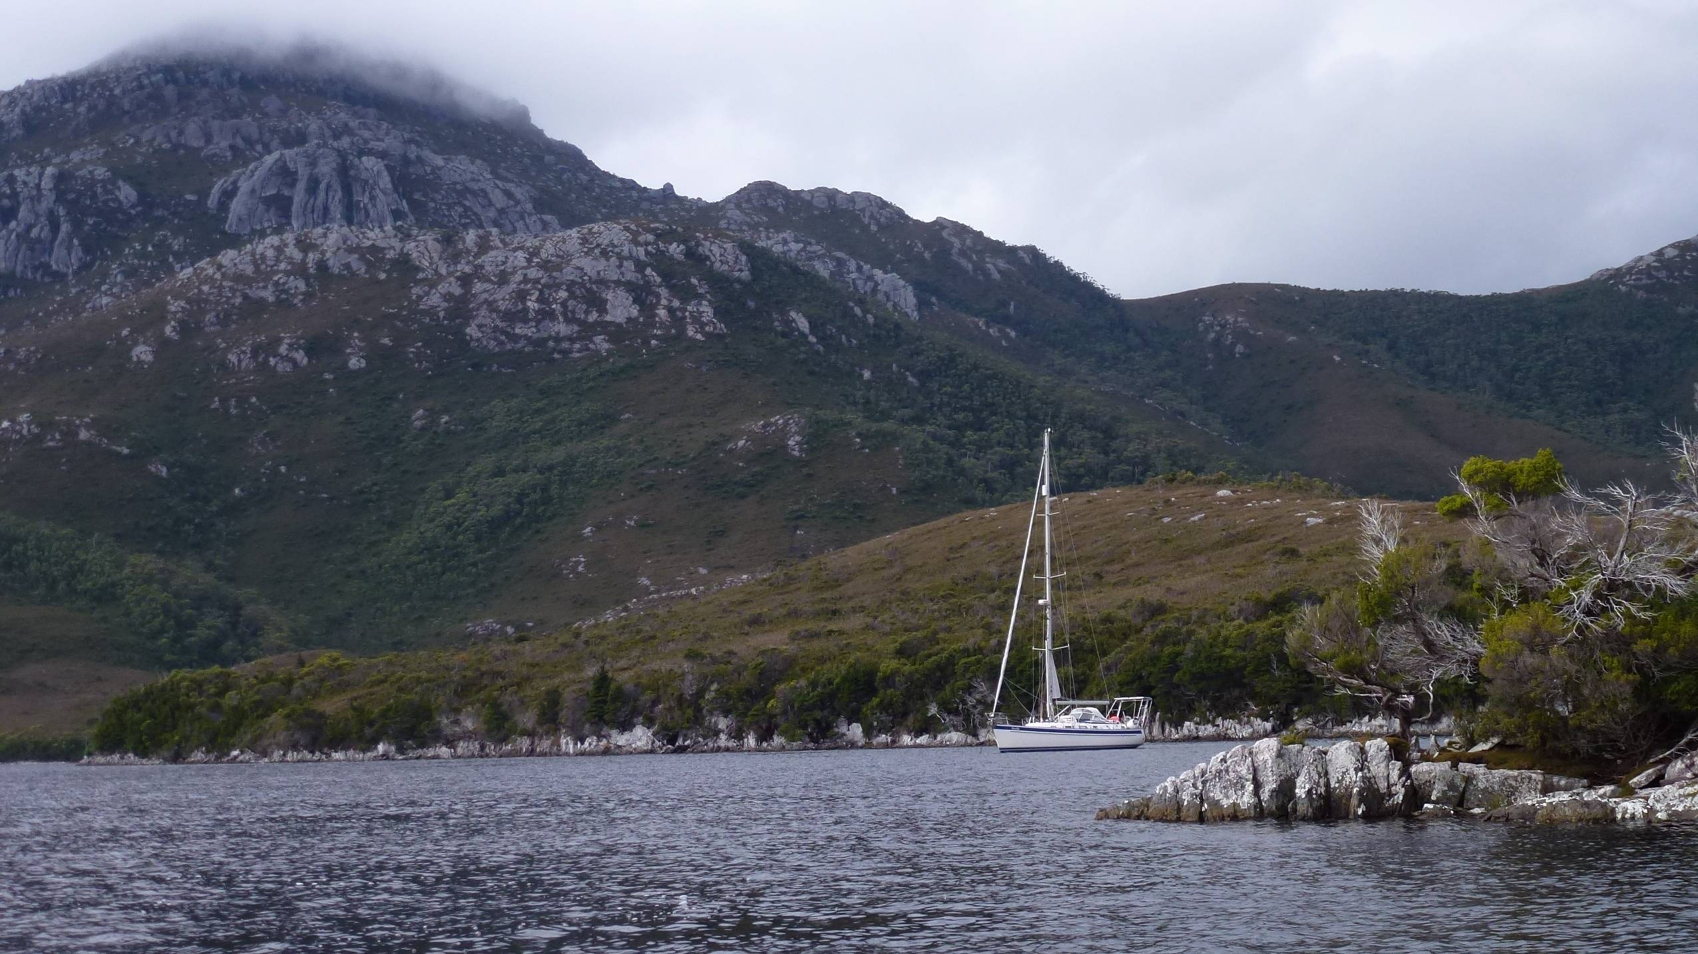
2018 Tasman Sea Crossings
Weather Predictions and Passage Routing
Rusalka

Slide 2
2018 Tasman Sea Crossings
Weather Predictions and Passage Routing
Rusalka
or
why we were wandering around in circles in the Tasman Sea

Slide 3
Rusalka
2018 Tasman Sea Crossings
Weather Predictions and Passage Routing
Briefly touch on:
The weather prediction models and forecasts we looked at
The ocean data we looked at
Where we got the information
How we accessed it
How this was used on passages:
Leg 1 Hobart to Nelson – uneventful
Leg 2 Nelson to Newcastle – challenging
Leg 3 Newcastle to Hobart – currents
Weather Predictions and Passage Routing

Slide 4
Weather Prediction Model Data We Used
GFS (Global Forecast System), from US NOAA, National Climate Centre – Global, 14 day forecast
ECMWF (European Centre for Medium Weather Forecasting), based in Reading UK – Global, 14 day forecast
PWE & PWG (PredictWind), a boutique forecaster licensed to run a CSIRO developed model – Global, 14 day forecast
ACCESS (Australian Community Climate and Eco System Simulator), Developed and run by BOM – Global and Regional, 7 and 3 day forecast
Weather Predictions and Passage Routing

Slide 5
Weather Prediction Model Data We Used
GFS (Global Forecast System), from US NOAA, National Climate Centre – Global, 14 day forecast
ECMWF (European Centre for Medium Weather Forecasting), based in Reading UK – Global, 14 day forecast
PWE & PWG (PredictWind), a boutique forecaster licensed to run a CSIRO developed model – Global, 14 day forecast
ACCESS (Australian Community Climate and Eco System Simulator), Developed and run by BOM – Global and Regional, 7 and 3 day forecast
Weather Predictions and Passage Routing

Slide 6
Weather Prediction Model Data We Used
GFS (Global Forecast System), from US NOAA, National Climate Centre – Global, 14 day forecast
ECMWF (European Centre for Medium Weather Forecasting), based in Reading UK – Global, 14 day forecast
PWE & PWG (PredictWind), a boutique forecaster licensed to run a CSIRO developed model – Global, 14 day forecast
ACCESS (Australian Community Climate and Eco System Simulator), Developed and run by BOM – Global and Regional, 7 and 3 day forecast
Weather Predictions and Passage Routing

Slide 7
Weather Prediction Model Data We Used
GFS (Global Forecast System), from US NOAA, National Climate Centre – Global, 14 day forecast
ECMWF (European Centre for Medium Weather Forecasting), based in Reading UK – Global, 14 day forecast
PWE & PWG (PredictWind), a boutique forecaster licensed to run a CSIRO developed model – Global, 14 day forecast
ACCESS (Australian Community Climate and Eco System Simulator), Developed and run by BOM – Global and Regional, 7 and 3 day forecast
Weather Predictions and Passage Routing

Slide 8
Weather Prediction Model Data We Used
GFS (Global Forecast System), from US NOAA, National Climate Centre – Global, 14 day forecast
ECMWF (European Centre for Medium Weather Forecasting), based in Reading UK – Global, 14 day forecast
PWE & PWG (PredictWind), a boutique forecaster licensed to run a CSIRO developed model – Global, 14 day forecast
ACCESS (Australian Community Climate and Eco System Simulator), Developed and run by BOM – Global and Regional, 7 and 3 day forecast
Weather Predictions and Passage Routing

Slide 9
Ocean Model Data We Used
BLUELINK Modular Ocean Model, Analysis and Prediction System, run by BOM, CSIRO and RAN, based on NOAA’s GFDL – Global and Regional, 7 day forecast
AUSWAVE, adapted from Wavewatch III developed by NOAA, using wind forcing from ACCESS – Global and Regional, 7 and 3 day forecast
PWE wave models from GPDL and ECMWF
Weather Predictions and Passage Routing

Slide 10
Ocean Model Data We Used
BLUELINK Modular Ocean Model, Analysis and Prediction System, run by BOM, CSIRO and RAN, based on NOAA’s GFDL – Global and Regional
AUSWAVE, adapted from Wavewatch III developed by NOAA, using wind forcing from ACCESS – Global and Regional, 7 and 3 day forecast
PWE wave models from GPDL and ECMWF
Weather Predictions and Passage Routing

Slide 11
Ocean Model Data We Used
BLUELINK Modular Ocean Model, Analysis and Prediction System, run by BOM, CSIRO and RAN, based on NOAA’s GFDL – Global and Regional
AUSWAVE, adapted from Wavewatch III developed by NOAA, using wind forcing from ACCESS – Global and Regional, 7 and 3 day forecast
PWE wave models from GPDL and ECMWF
Weather Predictions and Passage Routing

Slide 12
Ocean Model Data We Used
BLUELINK Modular Ocean Model, Analysis and Prediction System, run by BOM, CSIRO and RAN, based on NOAA’s GFDL – Global and Regional, 7 day forecast
AUSWAVE, adapted from Wavewatch III developed by NOAA, using wind forcing from ACCESS – Global and Regional, 7 and 3 day forecast
PWE wave models from GPDL and ECWF
Weather Predictions and Passage Routing

Slide 13
Other Weather Predictions
What about windy.com and willyweather.com.au and all the others??
Weather Predictions and Passage Routing

Slide 14
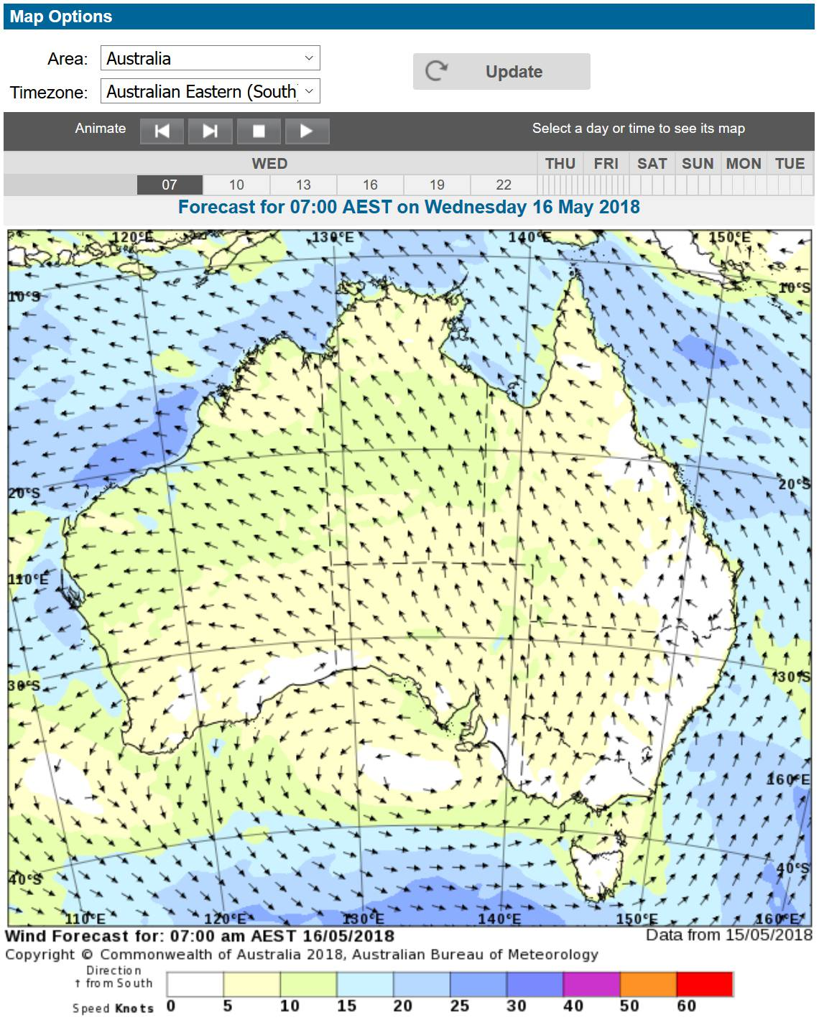
Where we got the forecasts
Bureau of Meteorology
PredictWind
Bob McDavitt (MetBob)
ACCESS
before departure
Weather Predictions and Passage Routing

Slide 15
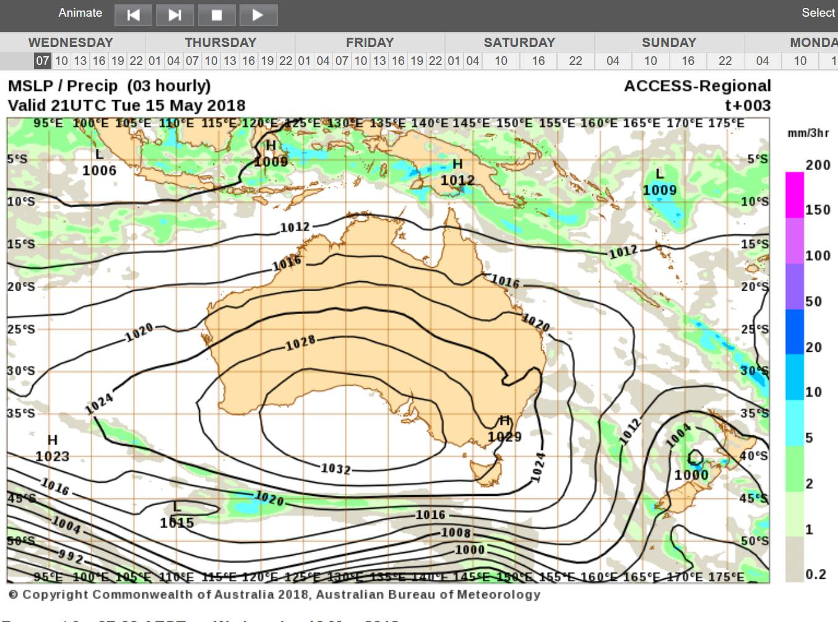
Where we got the forecasts
Bureau of Meteorology
PredictWind
Bob McDavitt (MetBob)
ACCESS before departure
Weather Predictions and Passage Routing

Slide 16
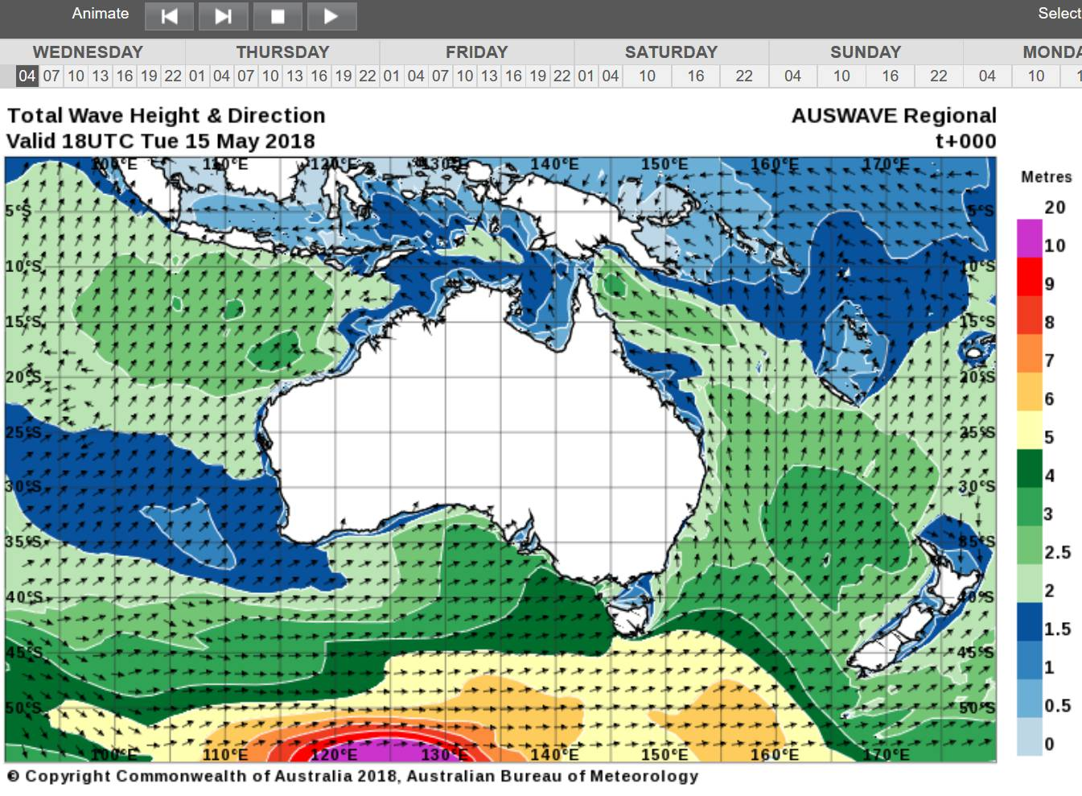
Where we got the forecasts
Bureau of Meteorology
PredictWind
Bob McDavitt (MetBob)
AUSWAVE before departure
Weather Predictions and Passage Routing

Slide 17
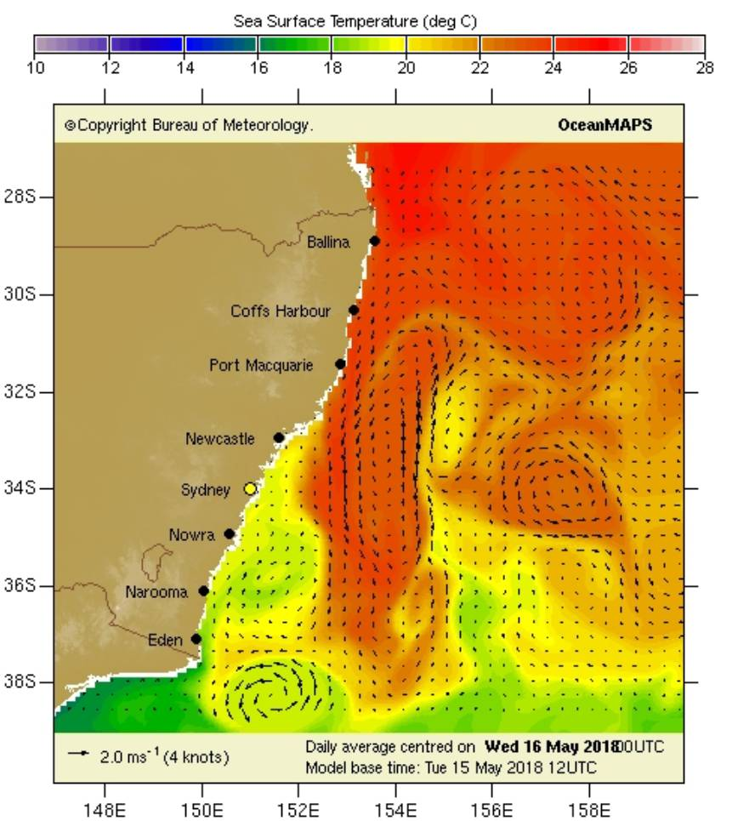
Where we got the forecasts
Bureau of Meteorology
PredictWind
Bob McDavitt (MetBob)
BLUELINK
before departure
Weather Predictions and Passage Routing

Slide 18
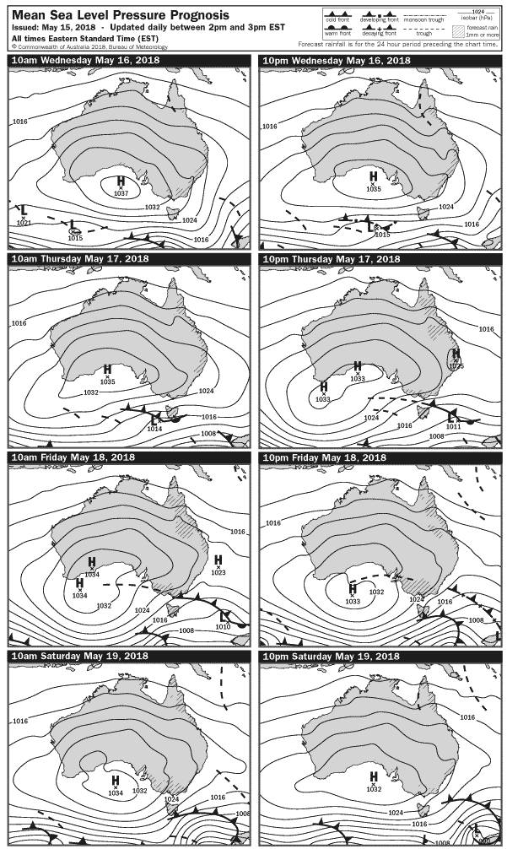
Where we got the forecasts
Bureau of Meteorology
PredictWind
Bob McDavitt (MetBob)
Other
on passage
Weather Predictions and Passage Routing

Slide 19
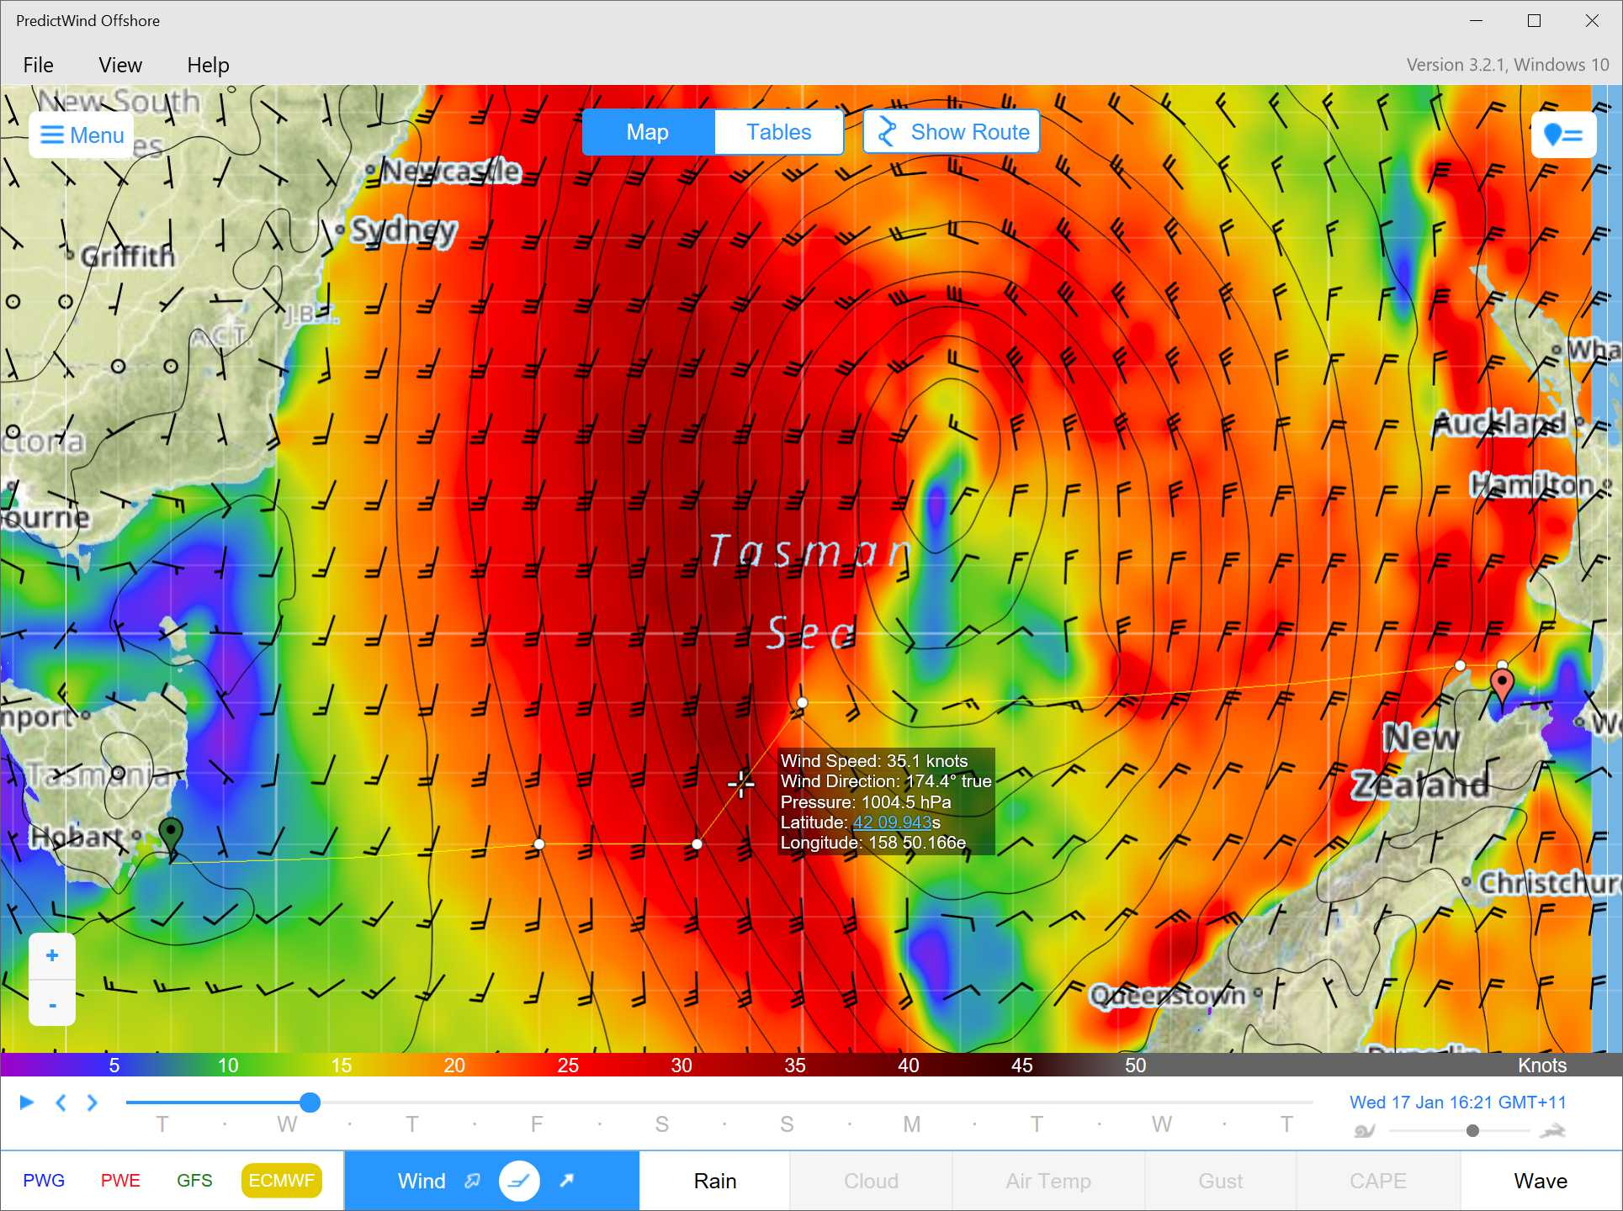
Where we got the forecasts
Bureau of Meteorology
PredictWind
Bob McDavitt (MetBob)
GFS, ECMWF, PWE, PWG on passage
Weather Predictions and Passage Routing

Slide 20
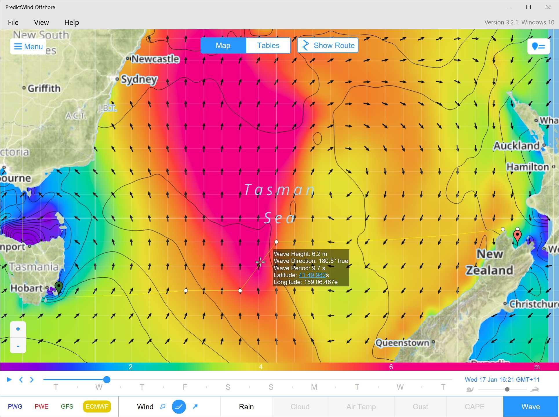
Where we got the forecasts
Bureau of Meteorology
PredictWind
Bob McDavitt (MetBob)
GFS, ECMWF, PWE, PWG on passage
Weather Predictions and Passage Routing

Slide 21
Where we got the forecasts
METAREA10.WARNING_SOUTH-EASTERN.0044.1600443853823
WOAU13 AMMC 160044
IDY21020
40:2:1:04:55S125E30045:11:00
SECURITE
High Seas Weather Warning for METAREA 10
Issued by the Australian Government Bureau of Meteorology, BNOC
At 0044UTC 16 May 2018
GALE WARNING FOR SOUTHEASTERN AREA
SITUATION AT 0000UTC
Vigorous westerly flow.
AREA AFFECTED
Bounded by 50S140E 50S160E 47S160E 49S140E 50S140E.
FORECAST
Westerly quarter winds 30/40 knots west of 143E at first, extending to west of 155E by 161200UTC and throughout by 161800UTC.
Winds easing below 34 knots west of 148E by 170000UTC.
Rough to very rough seas. Moderate to heavy swell.
Bureau of Meteorology
PredictWind
Bob McDavitt (MetBob)
GMDSS
Forecasts
on passage
Weather Predictions and Passage Routing

Slide 22
Where we got the forecasts
Bureau of Meteorology
PredictWind
Bob McDavitt (MetBob)
Routing and weather outlook on passage
Hi there Alex.
That front went thru North Island this morning with lots of squalls and lightning, two (known) tornadoes.
Yes these are huge swells, I was hoping they would be far apart enough to be gentle giants,
but in these strong winds the top 2metres are breaking waves,
and so be it, 325True.
We can possibly turn left to the SW again on Wednesday morning,
but that'd get us in difficult from strong adverse currents,/choppy seas
And so this suggests landfall at NEWCASTLE
If we went further SW along the coast then will encounter a strong SW change Sat night/Sunday.
SO here's update table to Newcastle. Usual decode , and in NZST , subtract 2 hours to get Aus time.
LT - HH:MM| Lat:/ Long :| hPa |lull~avg~gust|Brg-Kt |TWA|DRIFT to|Sig m
10-Apr-12:00|34:40S/161:20E|1017|-S-20~25~37|326-05.9|161|275-1.7|4.1
10-Apr-16:42|34:15S/160:59E|1018|-S-20~26~38|326-05.9|161|249-0.5|4.3
10-Apr-21:56|33:50S/160:40E|1021|SSE19~24~36|326-06.0|179|229-0.6|4.4
11-Apr-03:00|33:25S/160:20E|1022|-SE12~15~22|327-06.2|170|319-0.3|4.3
When swells and wind eae try 300true, can take this turn gradually
11-Apr-07:41|33:00S/160:00E|1023|-SE12~15~22|300-06.2|160|335-0.7|4.2
11-Apr-16:59|32:30S/158:59E|1023|-SE05~06~09|301-04.8|166|308-1.4|3.8*
At 32S go west, brace for strong current from the south
Weather Predictions and Passage Routing

Slide 23
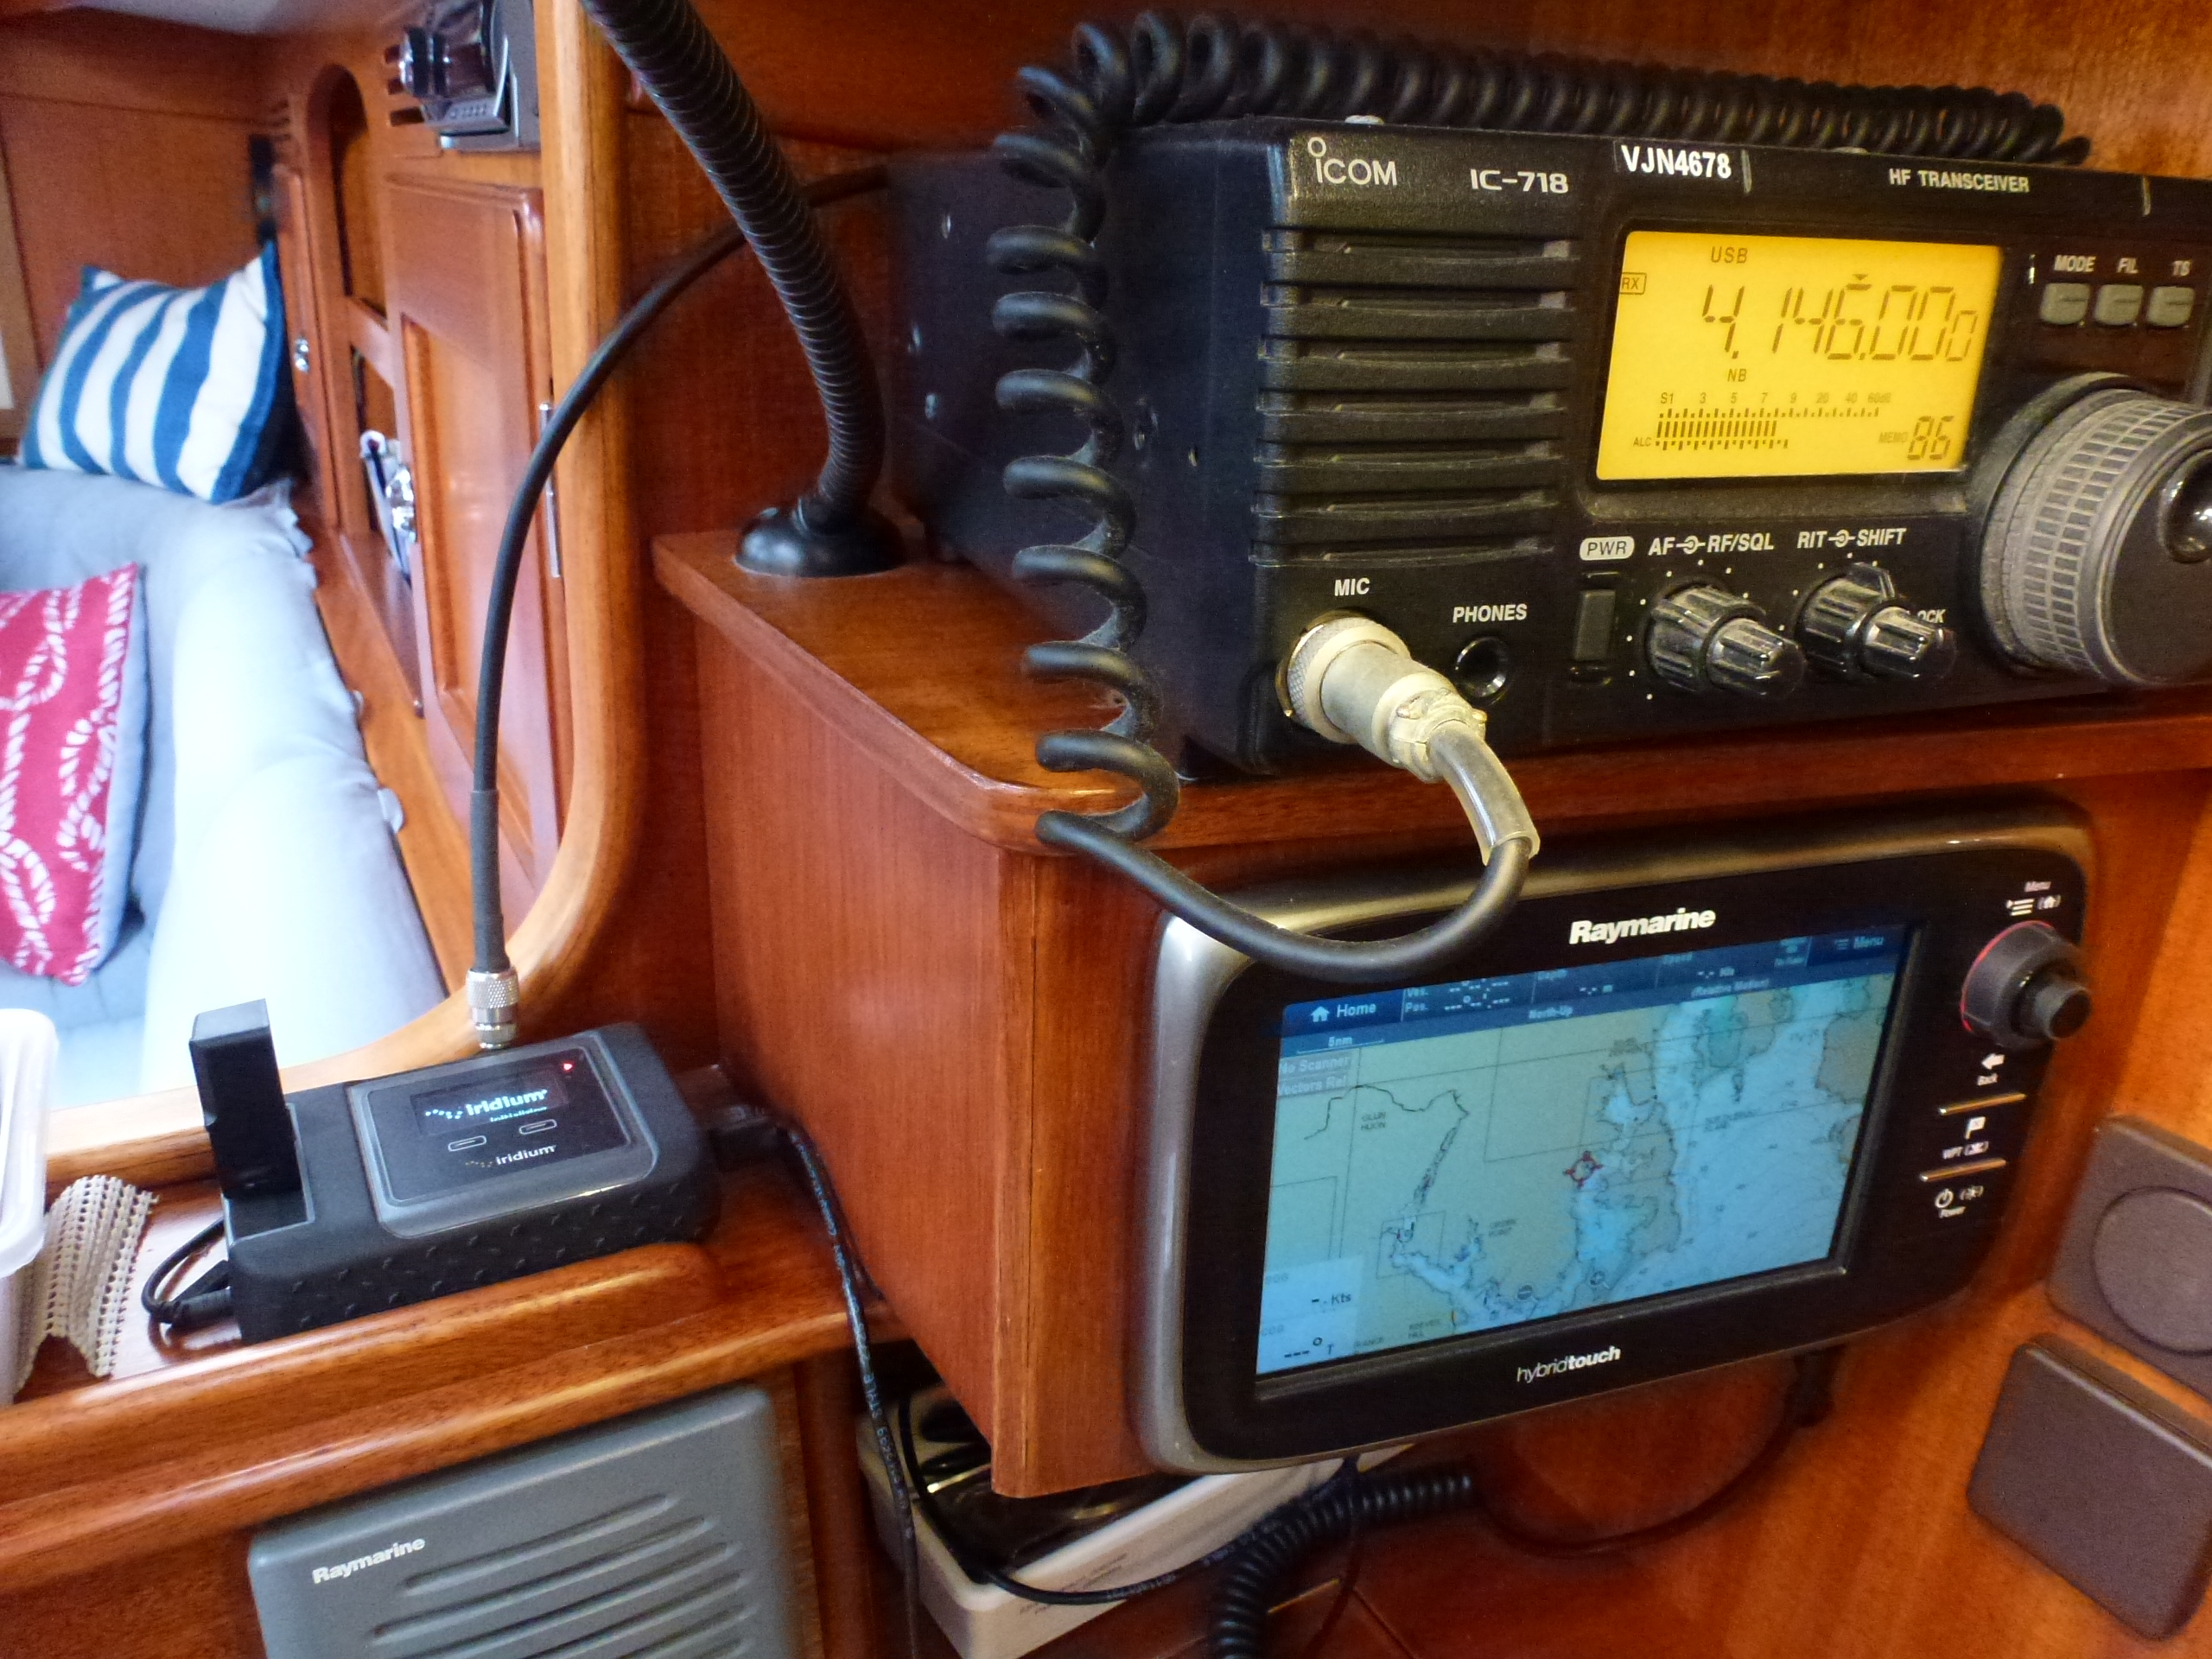
How we got the forecasts on Rusalka
Internet obviously before departure and whilst available.
IridiumGO! on passage.
HF on passage*.
Weather Predictions and Passage Routing

Slide 24
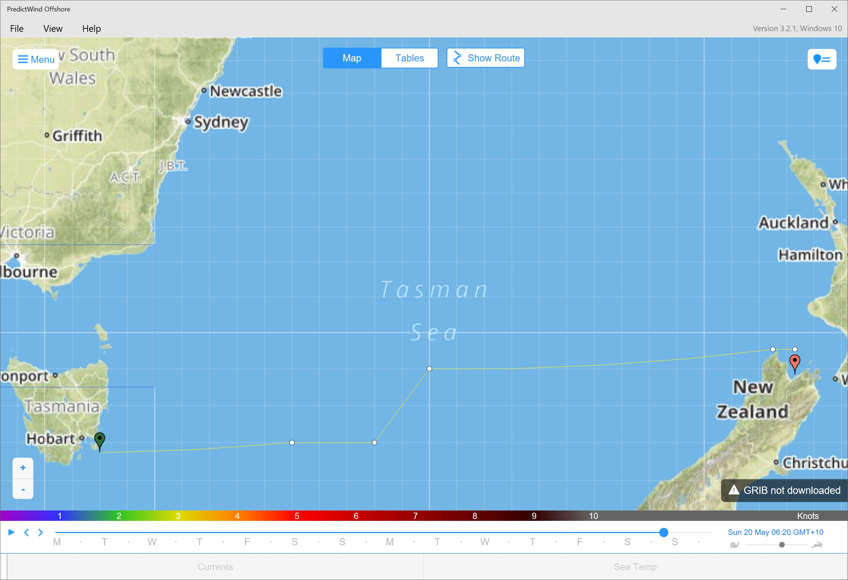
Leg 1 – Hobart to Nelson
Gribs:
9:30pm
15/1/2018
Initial Route
Hobart to Nelson

Slide 25
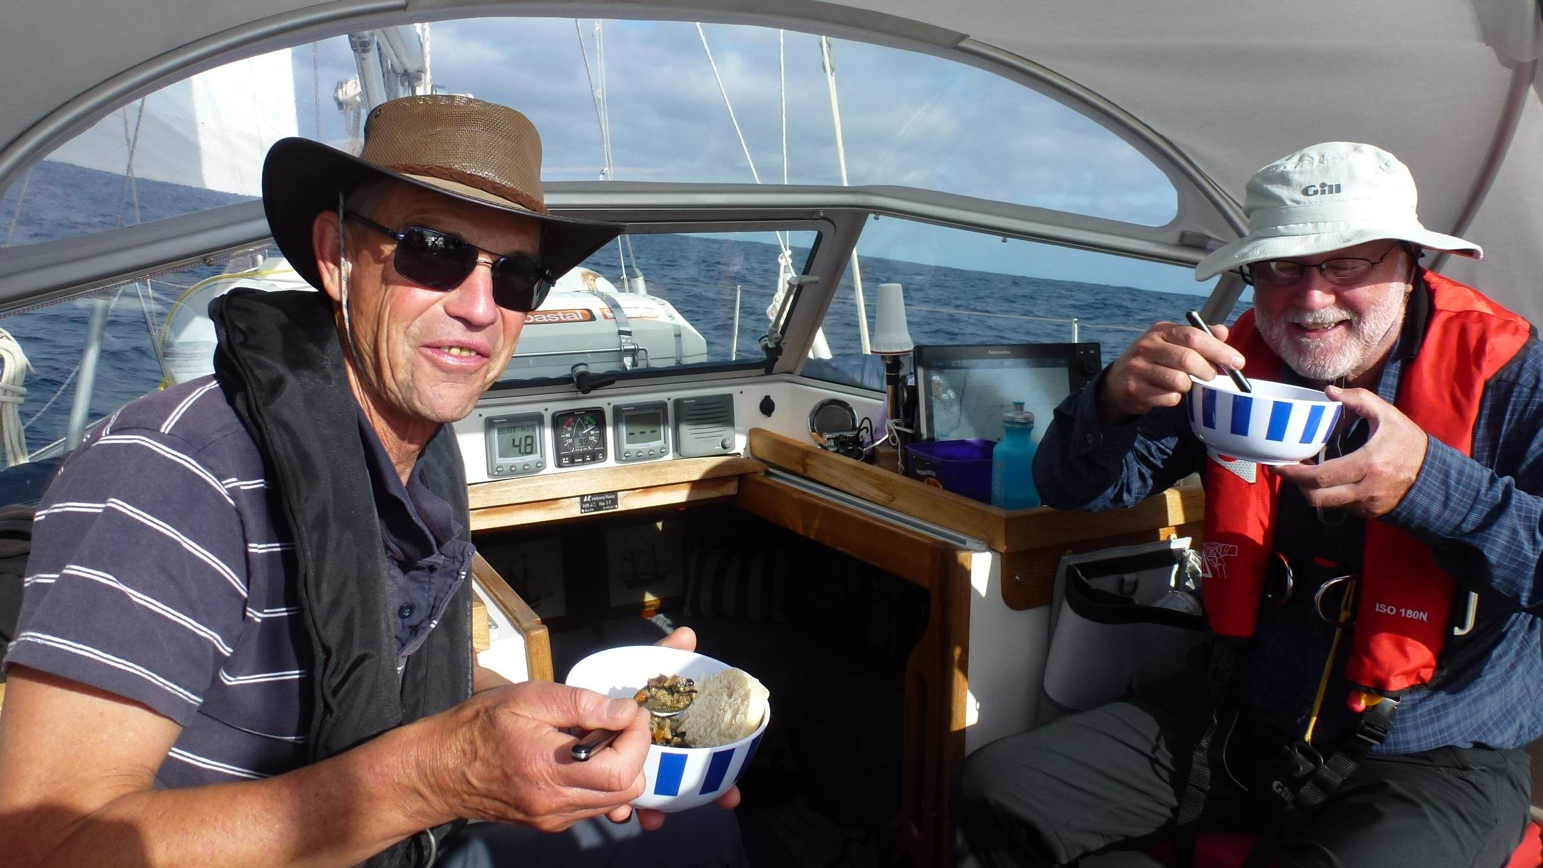
Leg 1 – Hobart to Nelson
First evening meal

Slide 26
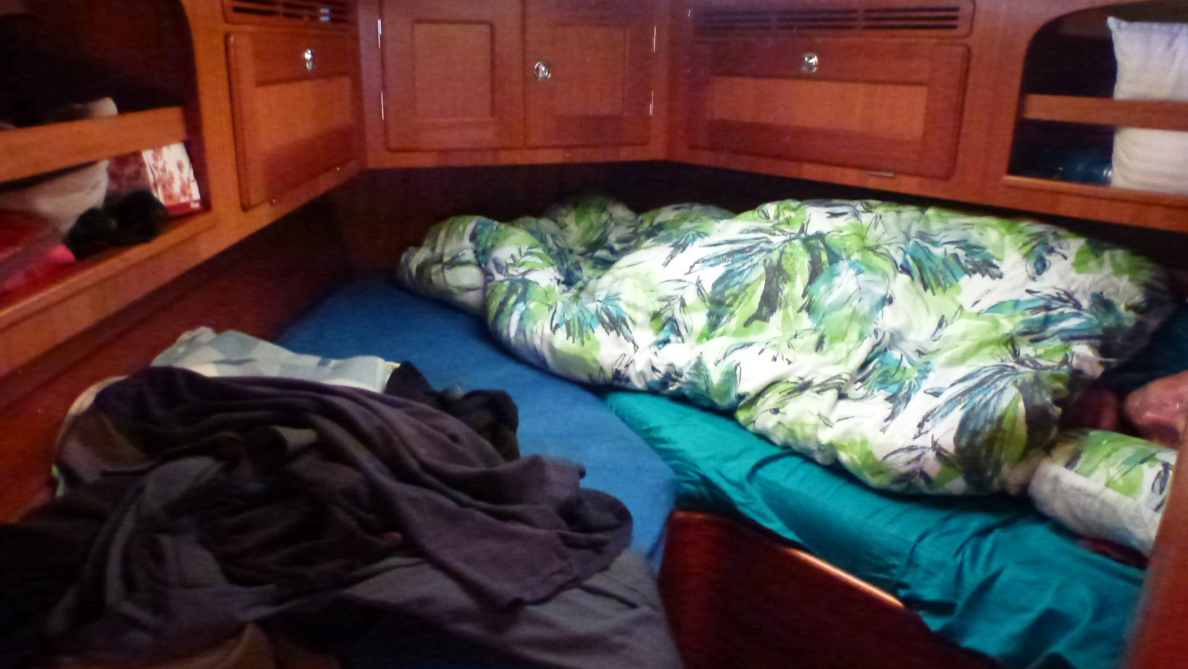
Leg 1 – Hobart to Nelson

Slide 27
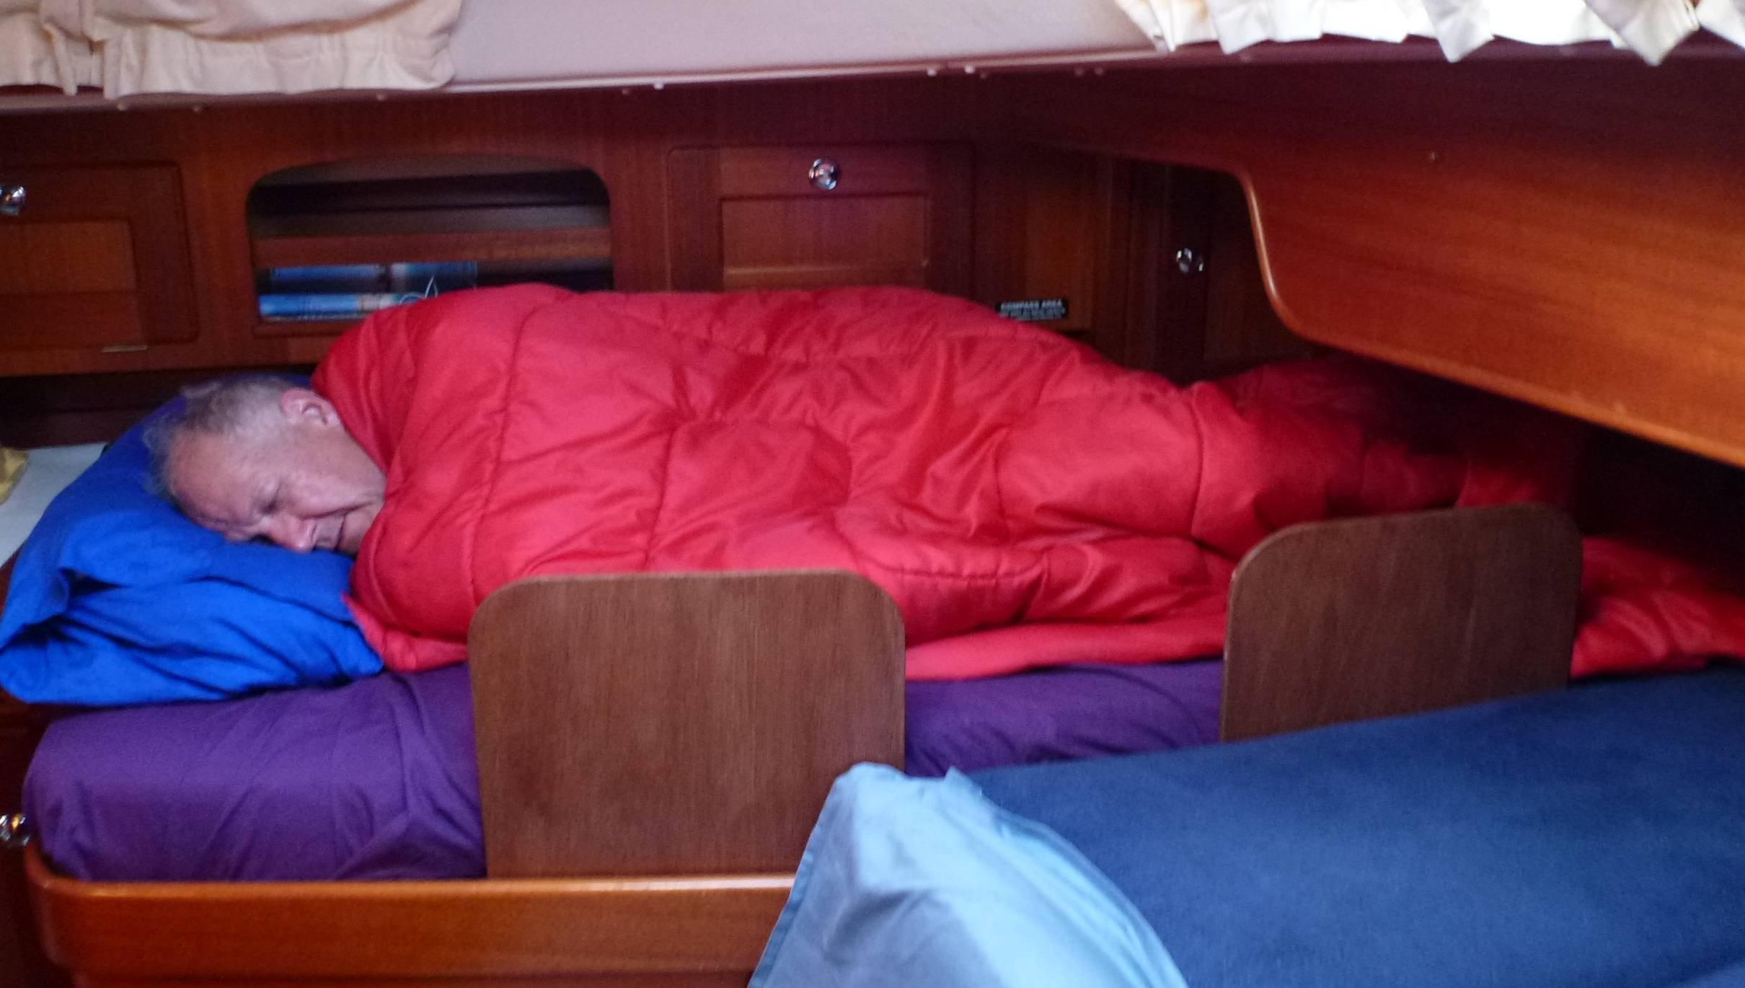
Leg 1 – Hobart to Nelson

Slide 28
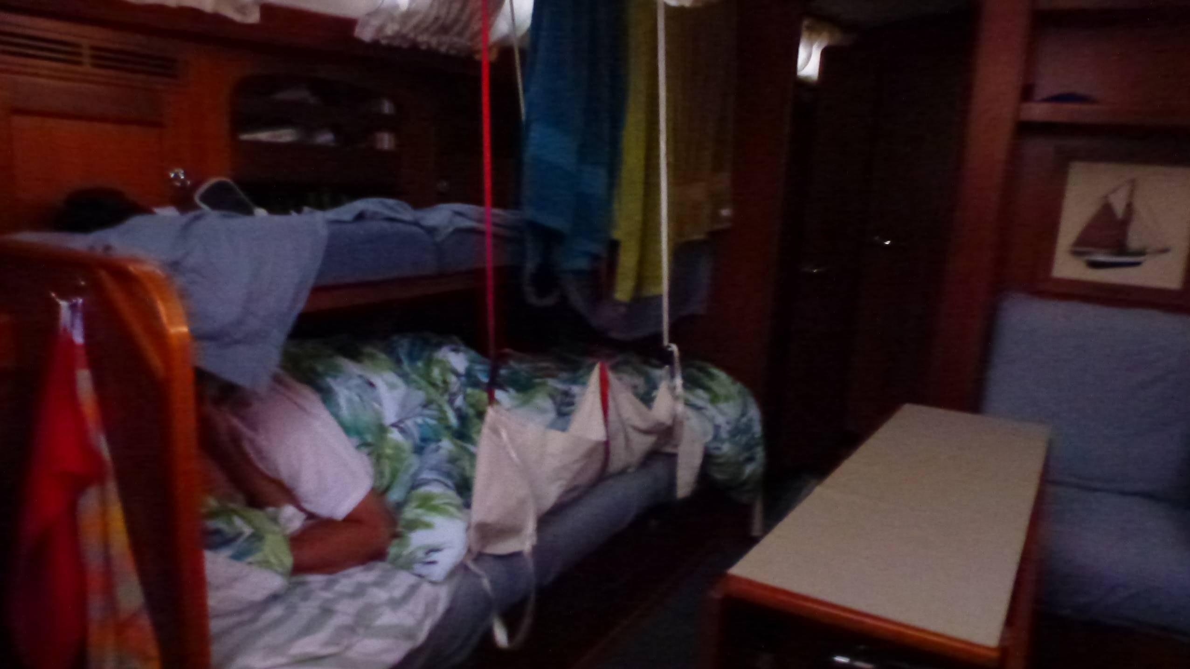
Leg 1 – Hobart to Nelson

Slide 29
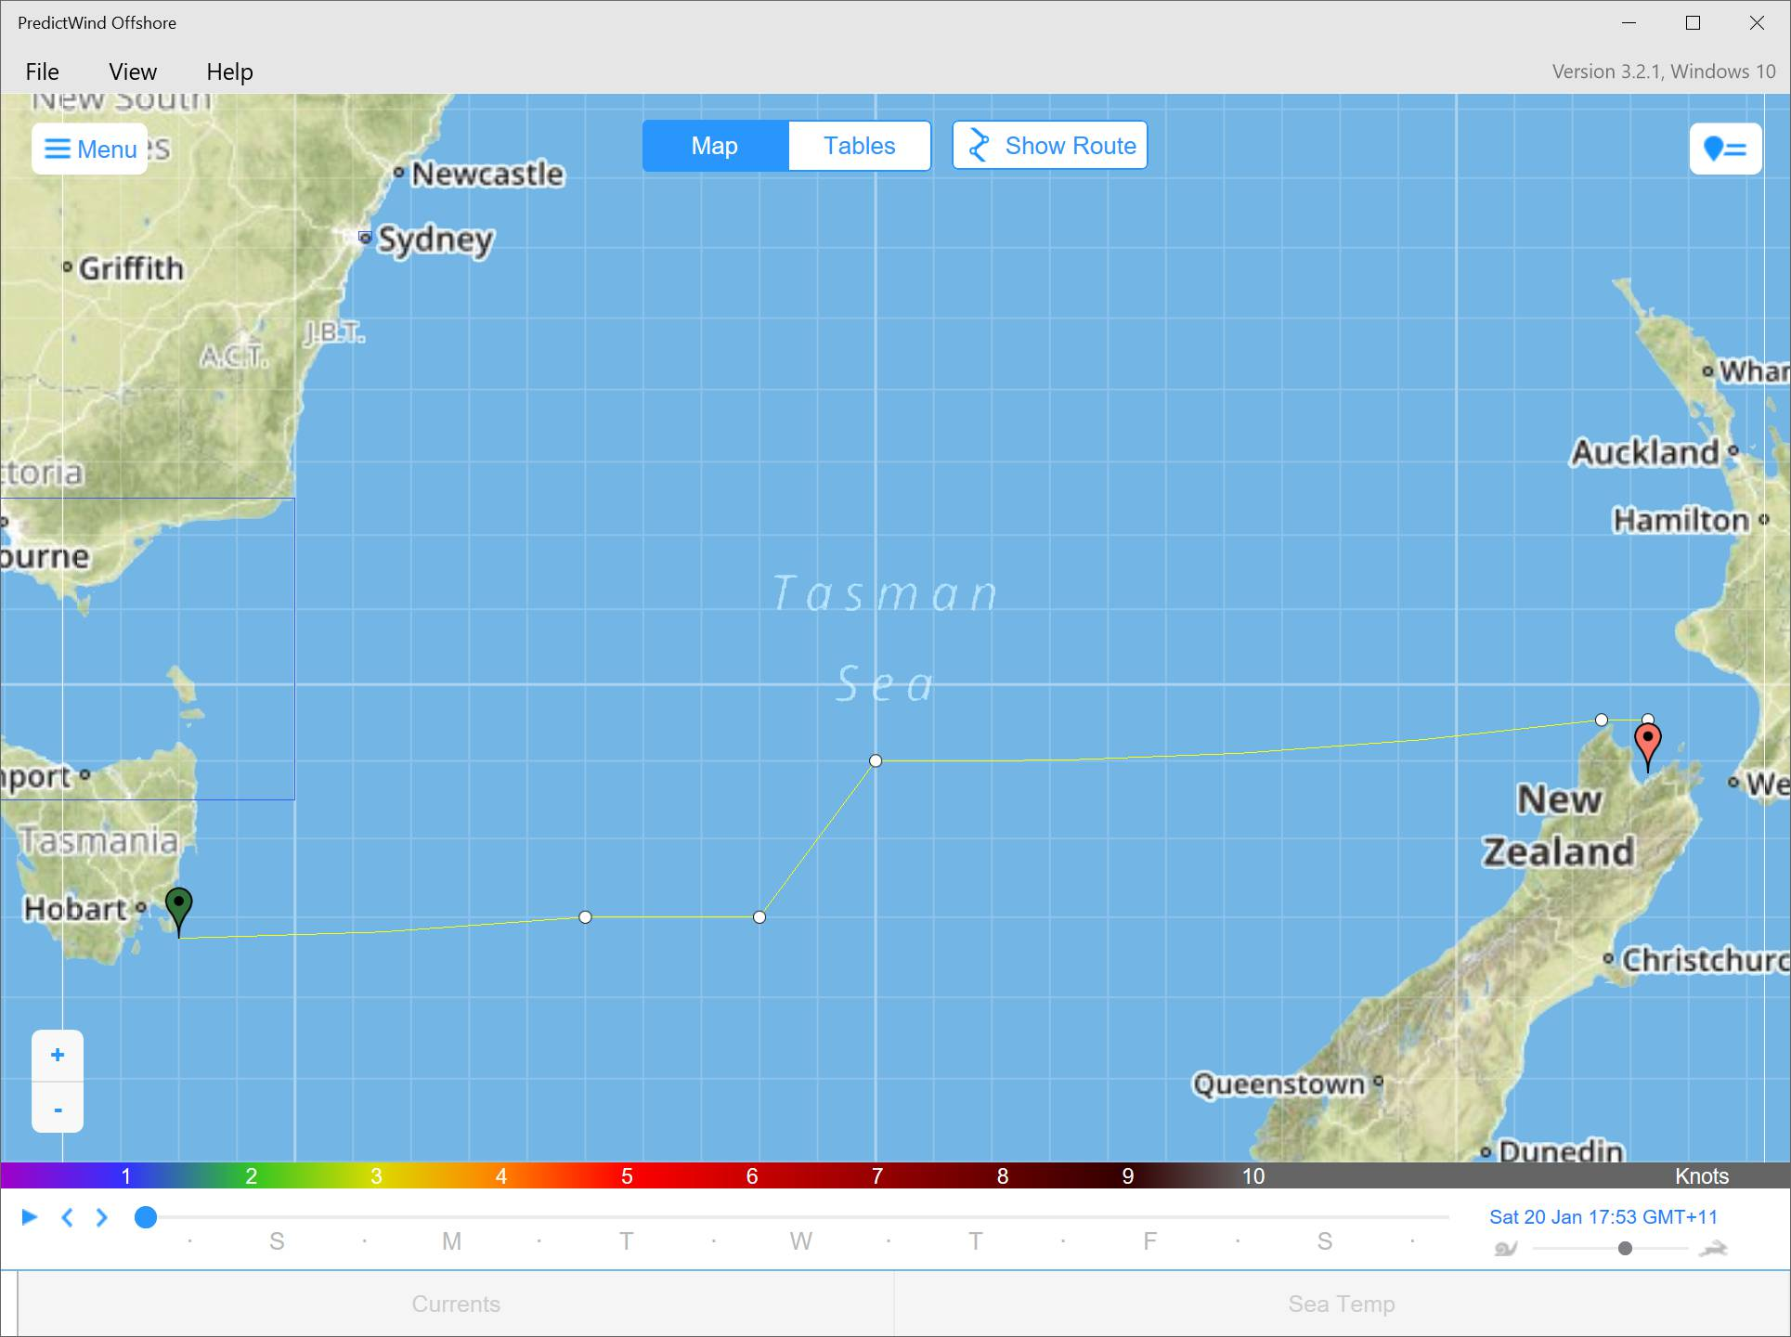
Leg 1 – Hobart to Nelson
See Gribs:
3:40pm
18/1/2018
Initial Route
Hobart to Nelson

Slide 30

Leg 1 – Hobart to Nelson
No Change to Route
Hobart to Nelson

Slide 31
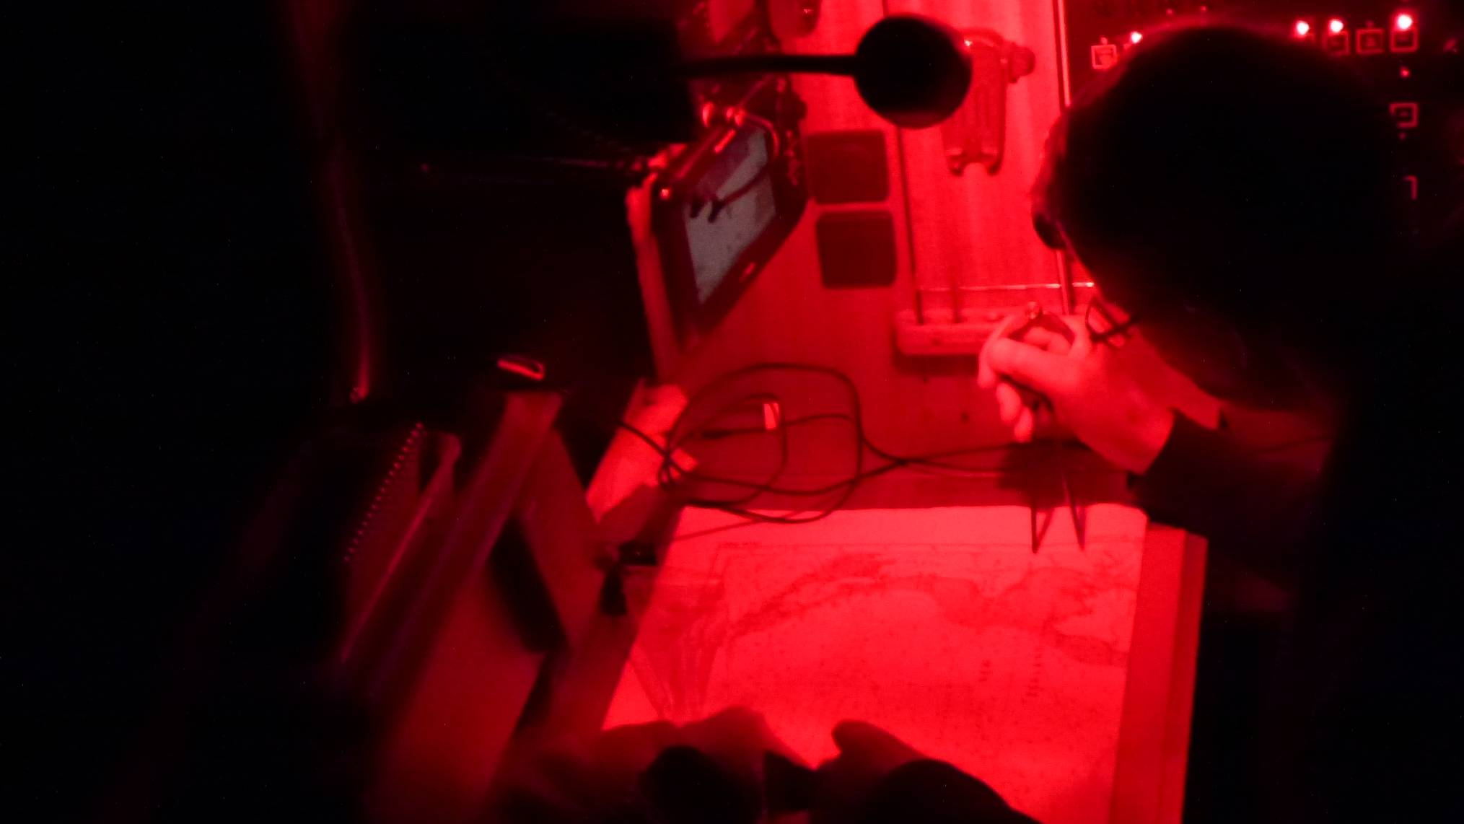
Leg 1 – Hobart to Nelson

Slide 32
Leg 1 – Hobart to Nelson, approaching NZ, midday
Video removed, see youtube:
https://youtu.be/rZ-FkAJl-hI
Weather Predictions and Passage Routing

Slide 33
Leg 1 – Hobart to Nelson, mid afternoon
Video removed, see youtube:
https://youtu.be/Qb2CqNKa4IA
Weather Predictions and Passage Routing

Slide 34
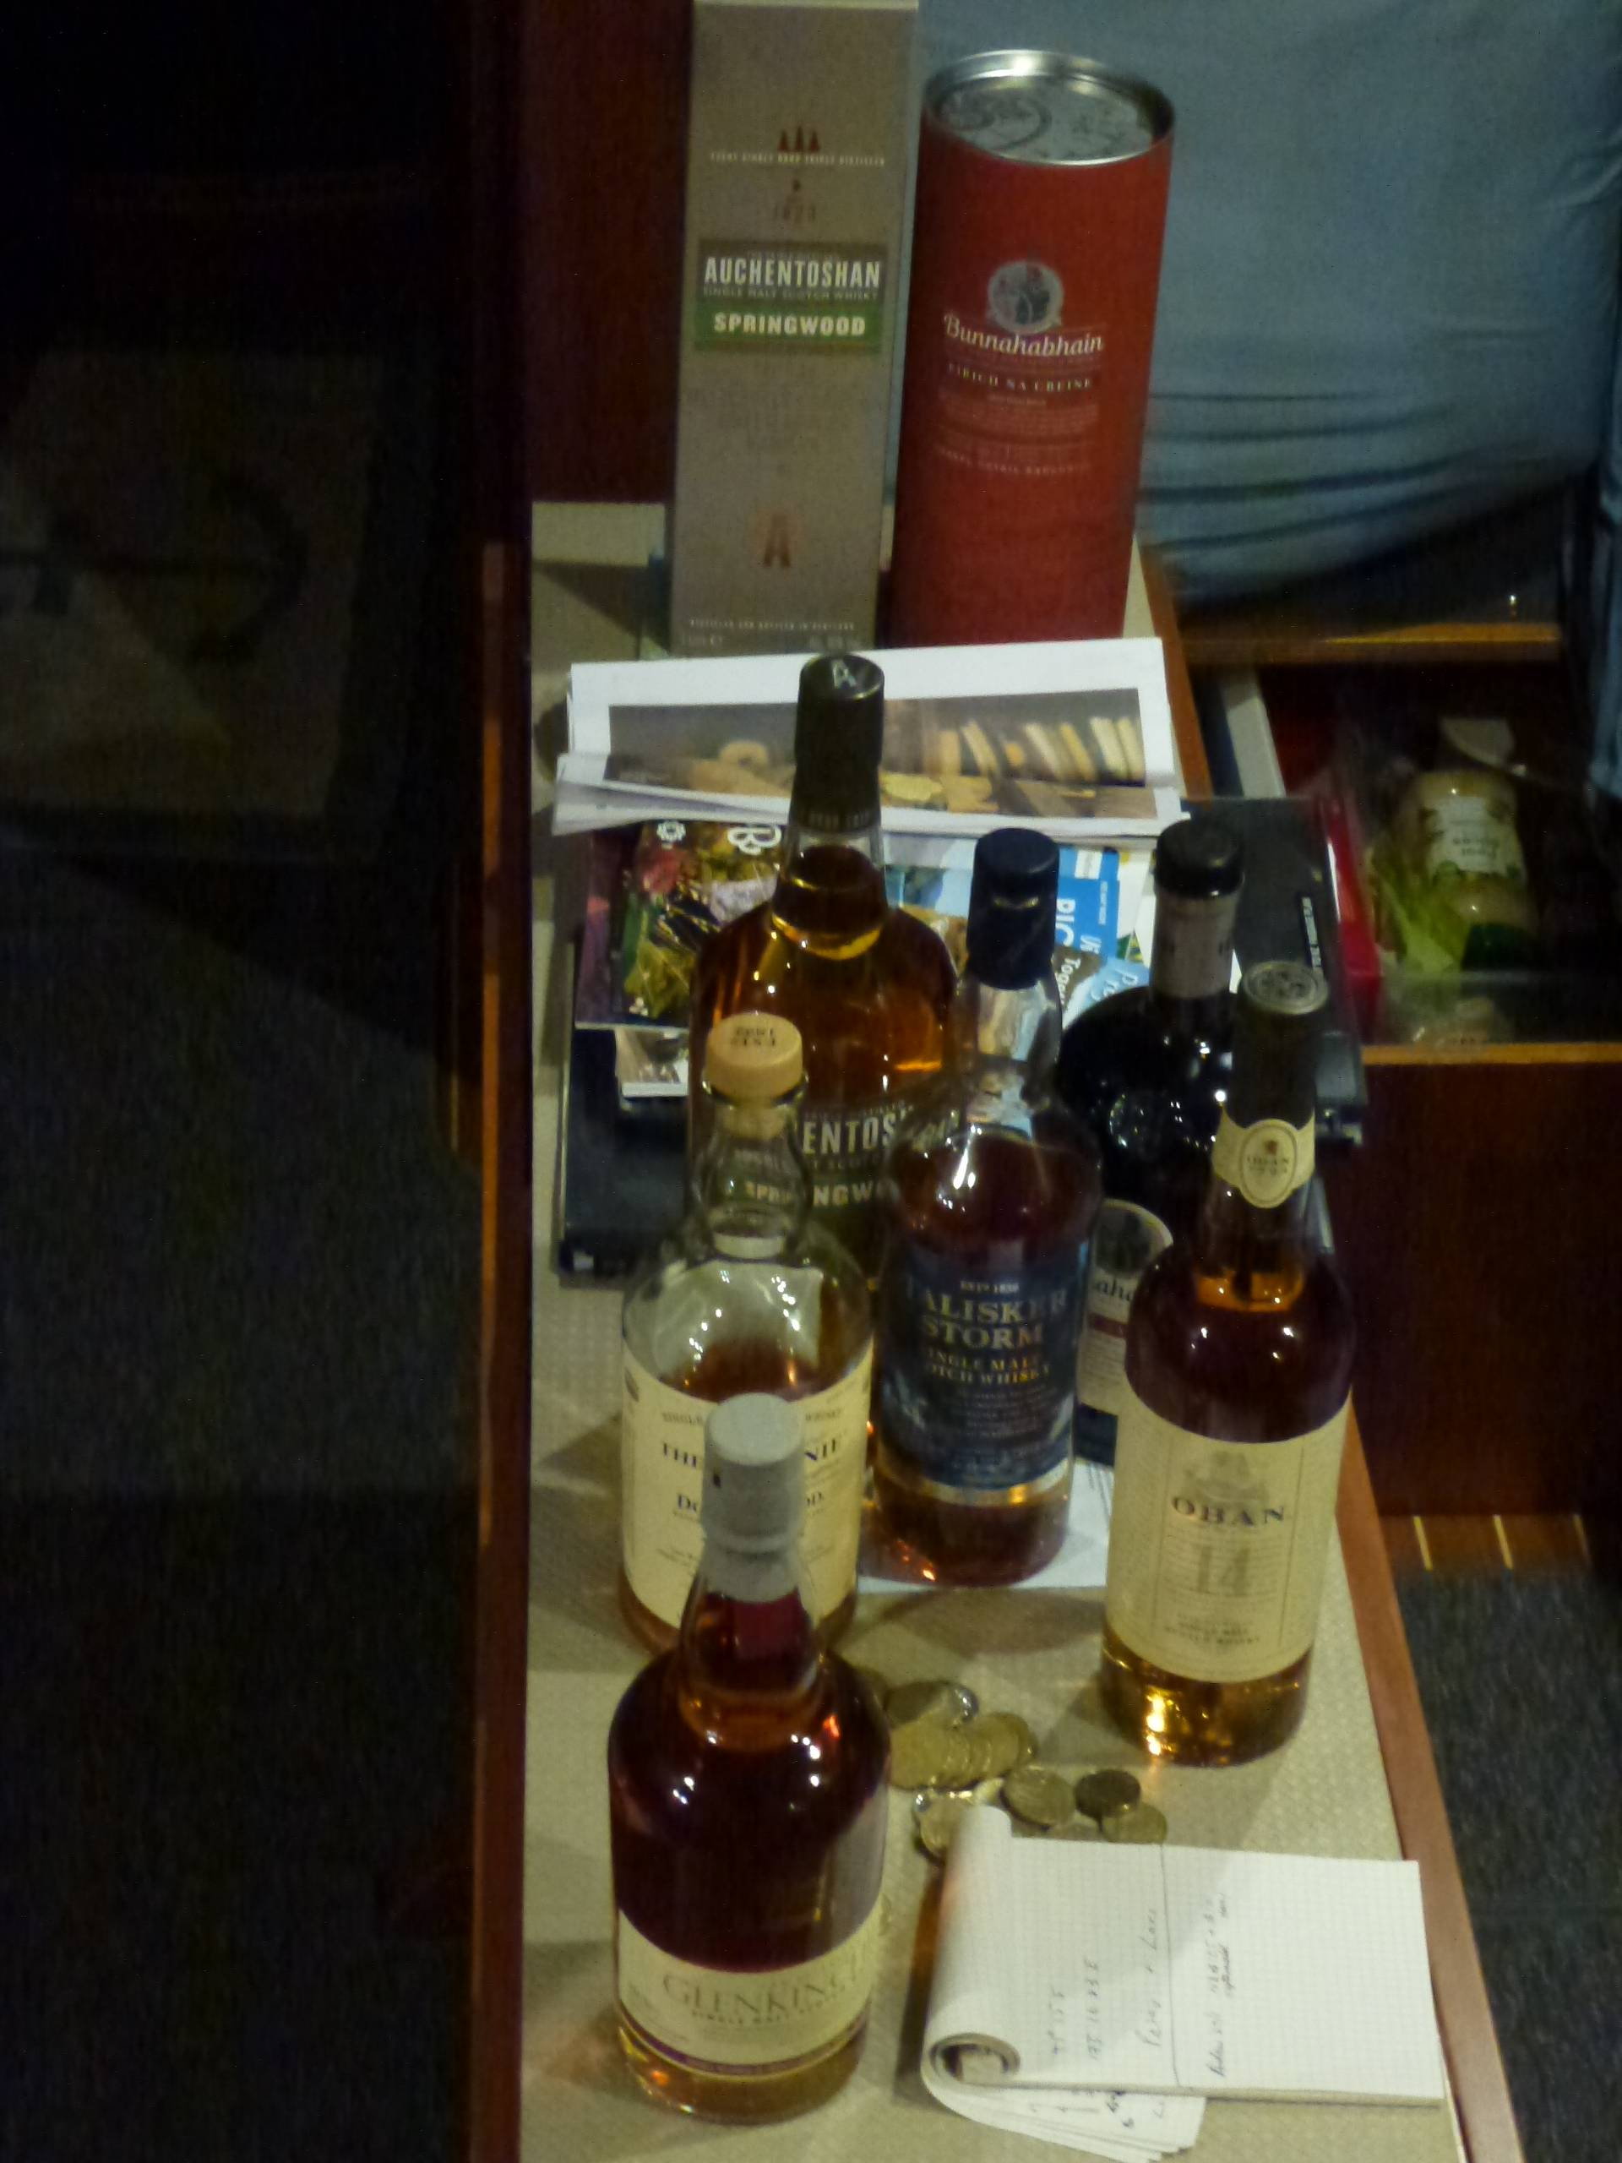
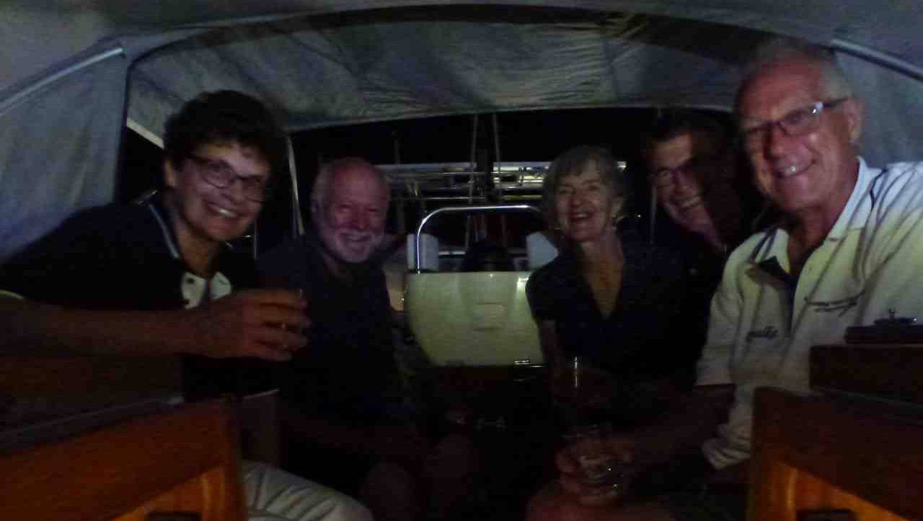
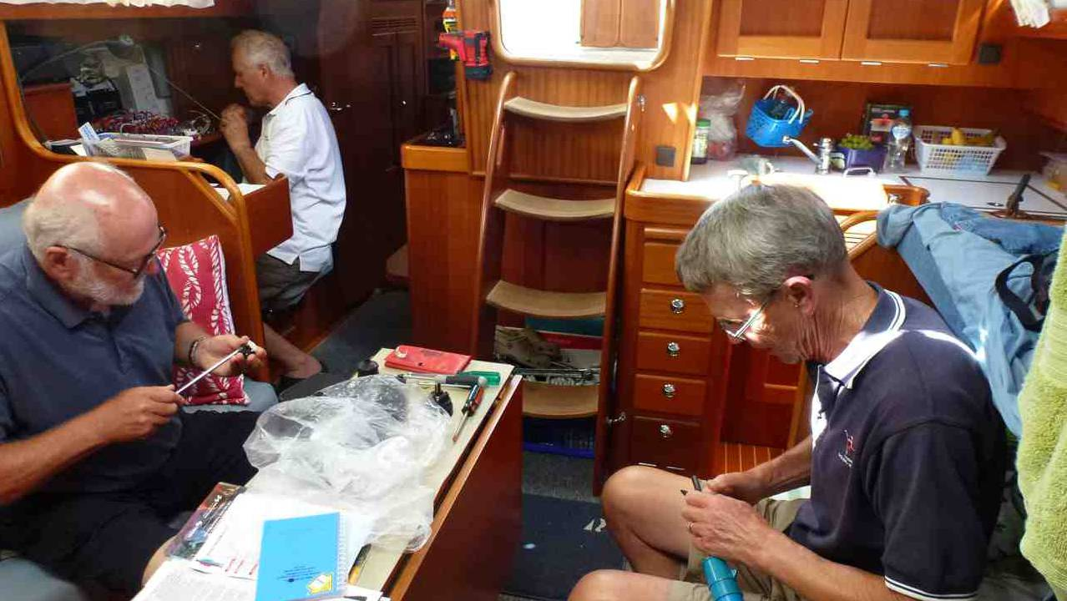
Leg 1 – Hobart to Nelson, arrived

Slide 35
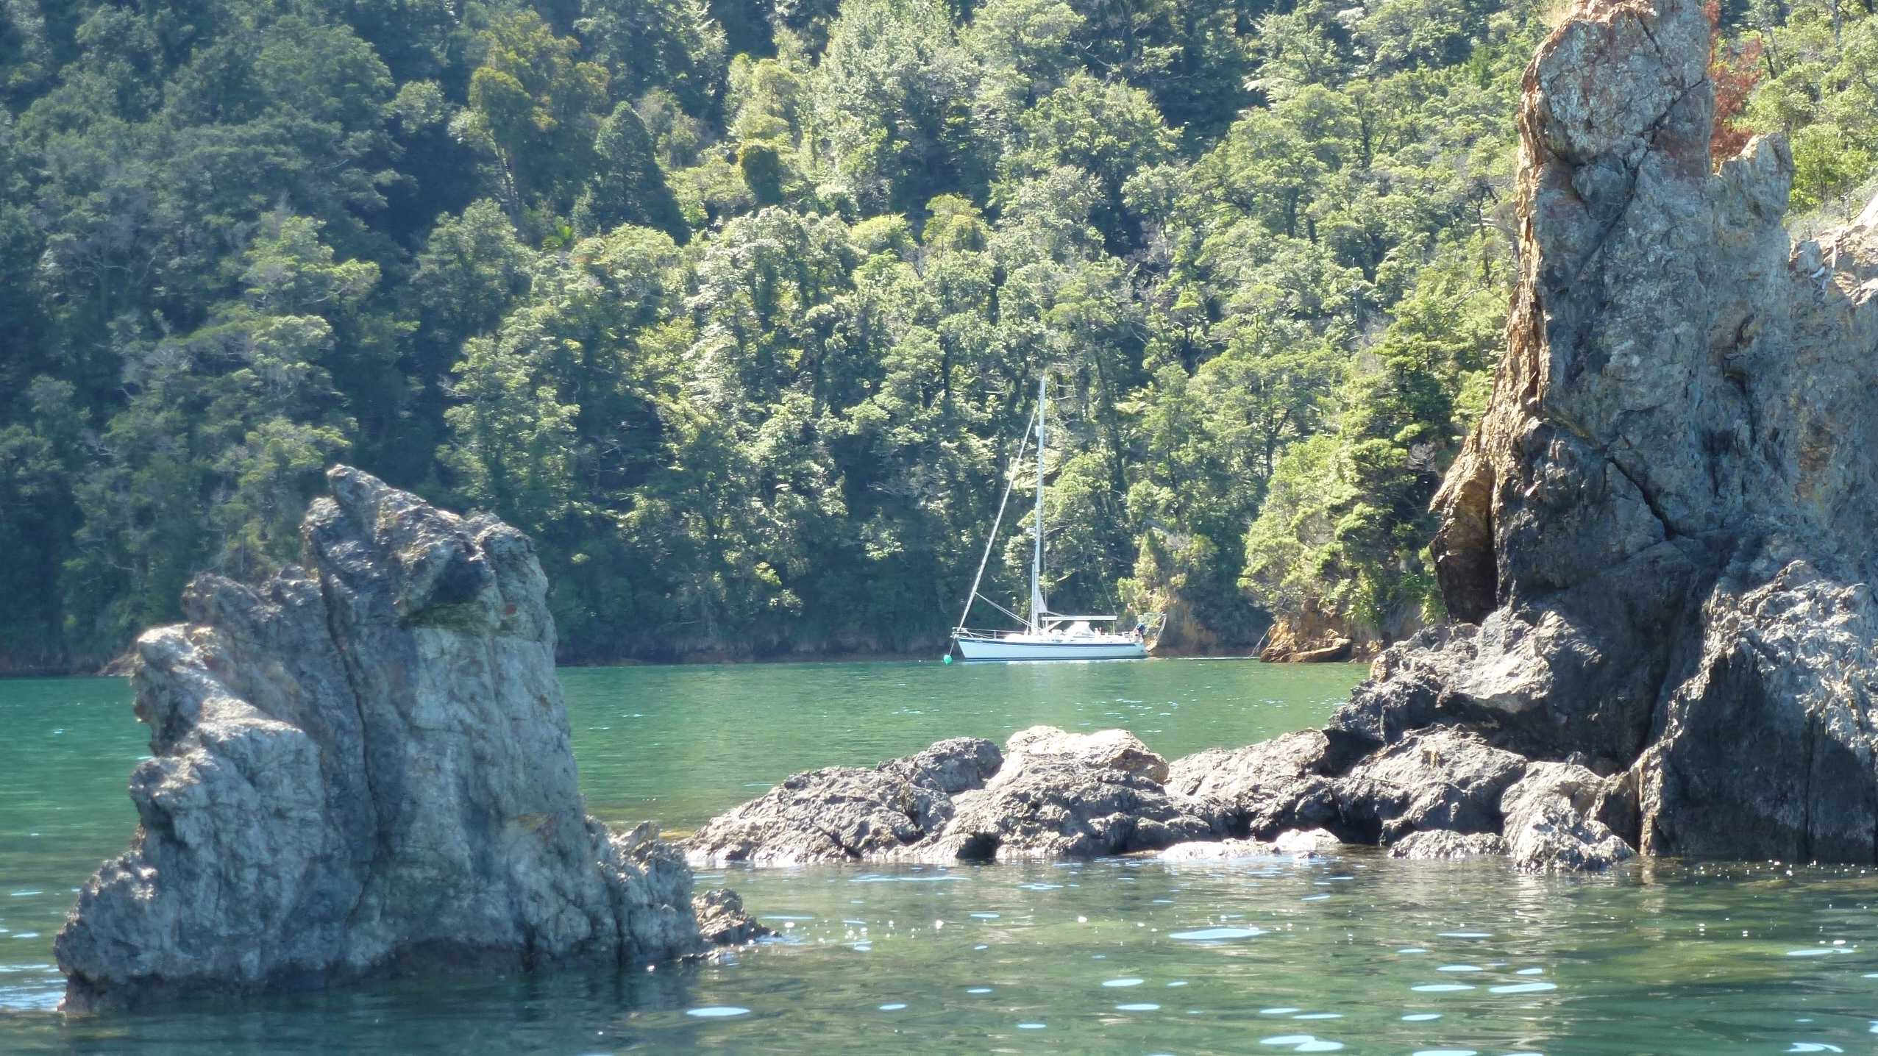
Leg 2 – Nelson to Eden, after cruising the Sounds

Slide 36
Leg 2 – Nelson to Eden
See Gribs:
5:30am
02/4/2018
Possible front Tuesday 10th
Esp seen on PWE and BobMacD
Comfort criteria
Initial Nelson to Eden
Synoptic Outlook
Weather Predictions and Passage Routing

Slide 37
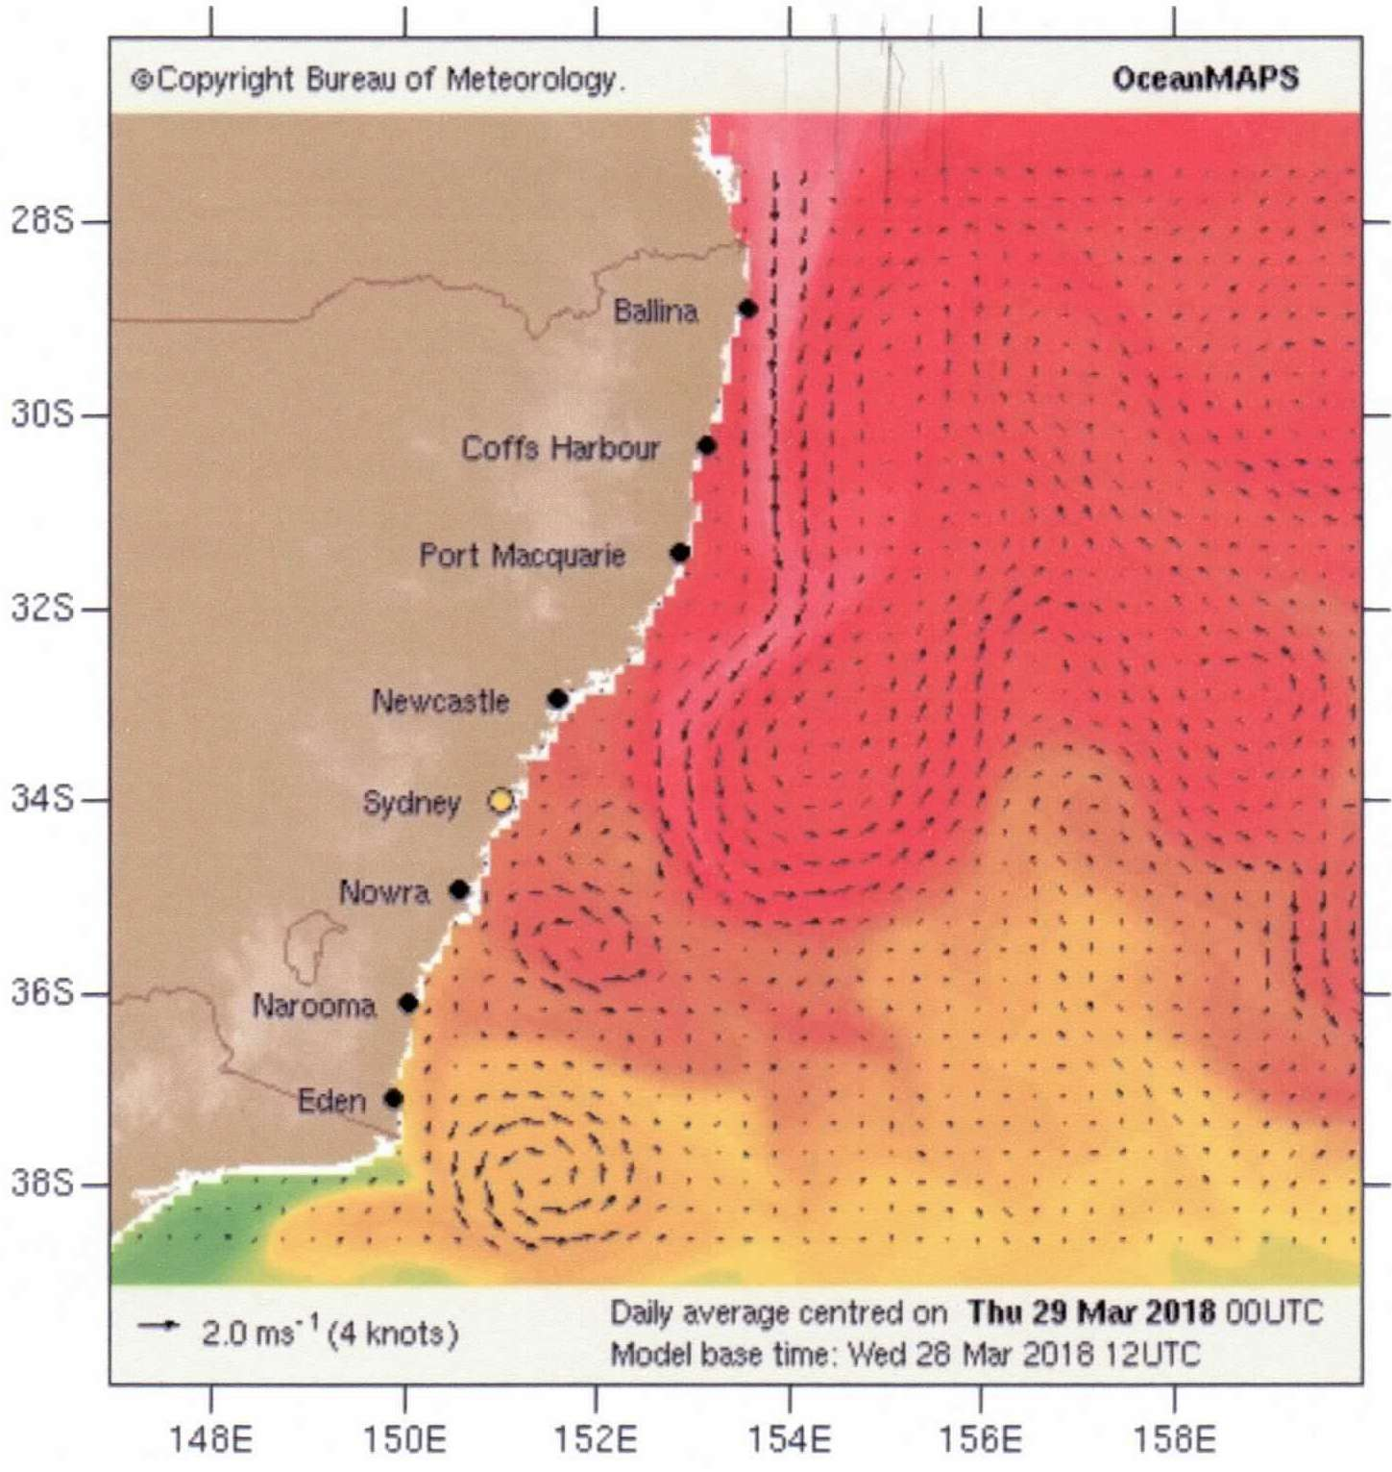
Leg 2 – Nelson to Eden
Initial Nelson to Eden
Tasman Currents
Weather Predictions and Passage Routing

Slide 38
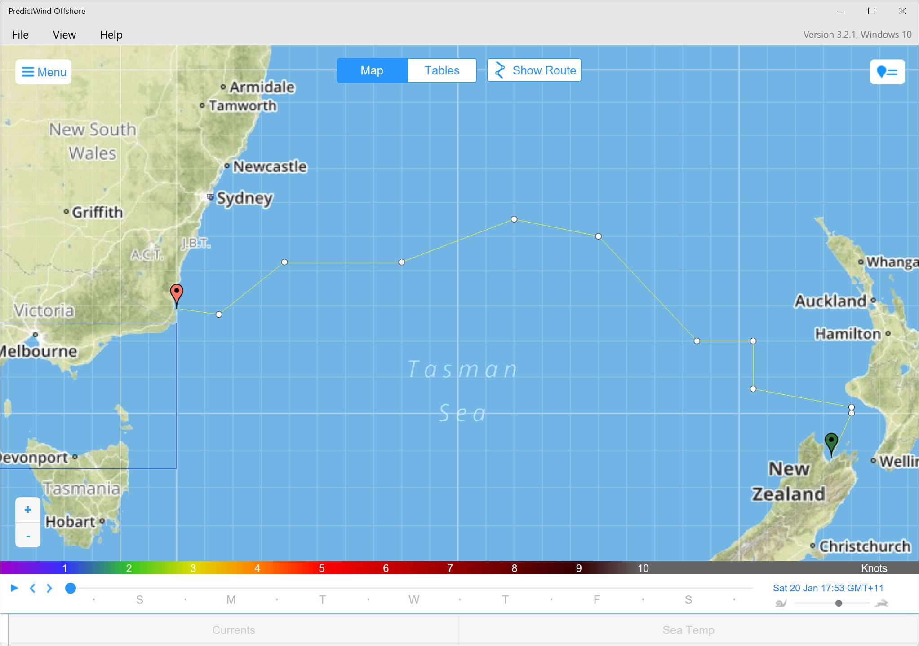
Leg 2 – Nelson to Eden (Newcastle)
See Gribs:
5:30am
02/4/2018
Possible front Tuesday 10th
Esp seen on PWE and BobMacD
Comfort criteria
Initial Route
Nelson to Eden

Slide 39
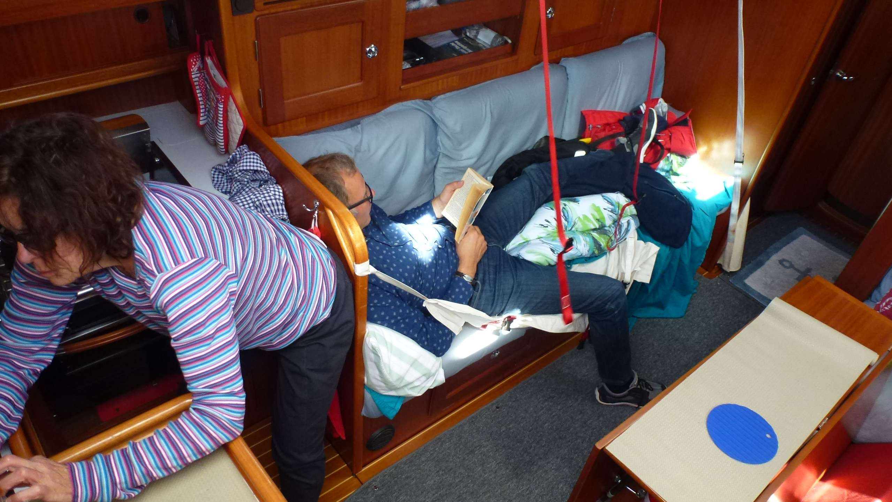
Leg 2 –Nelson to Eden

Slide 40
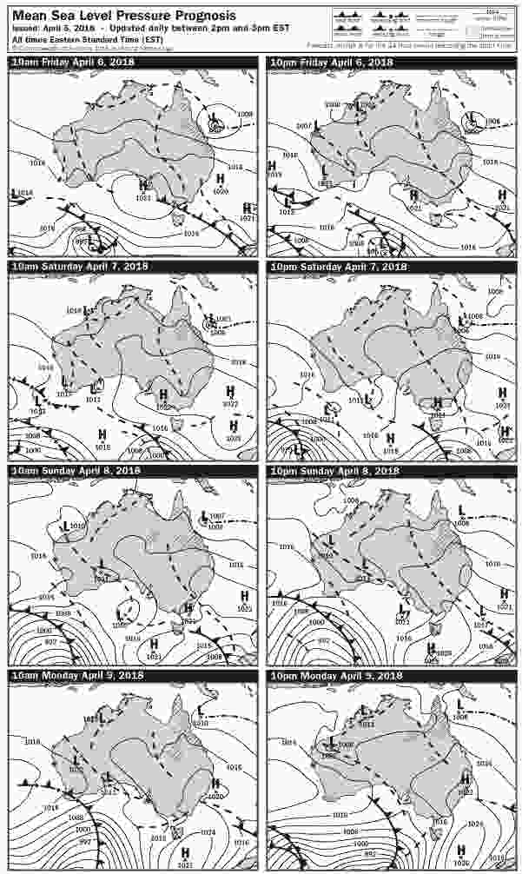
Leg 2 – Nelson to Eden
See Gribs:
8:00pm
06/4/2018
Possible front Tuesday 10th
Esp on PWE and BobMacD
Nelson to Eden after 3 days
Synoptic Outlook
Weather Predictions and Passage Routing

Slide 41
Leg 2 – Hobart to Eden
See Gribs:
8:30pm
07/4/2018
Front & low expected midnight Mon 9th
Adjust Sun/Mon headings
Initial Route
Nelson to Eden

Slide 42
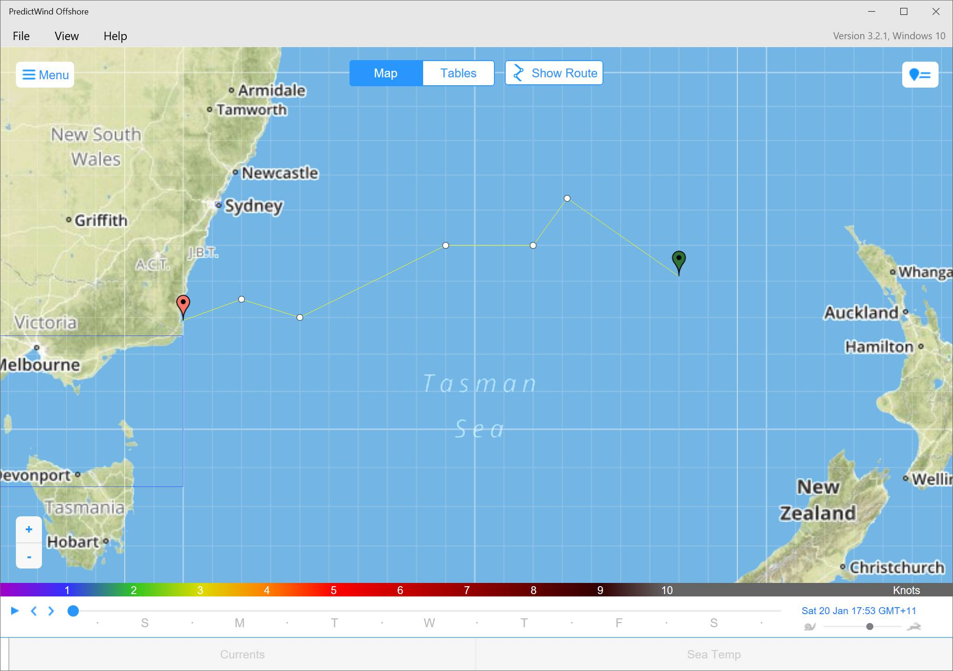
Leg 2 – Nelson to Eden
See Gribs:
8:30pm
07/4/2018
Front & low expected midnight Mon 9th
Adjust Sun/Mon headings
First Route Change
Nelson to Eden

Slide 43
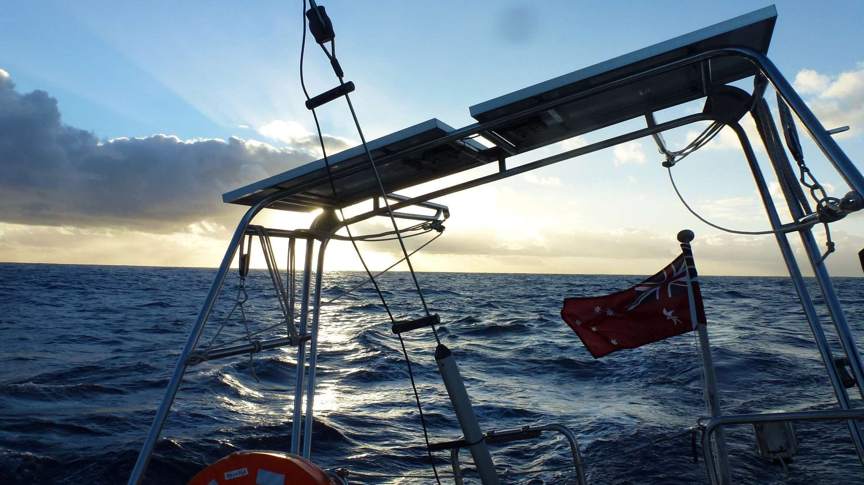
Leg 2 –Nelson to Eden

Slide 44
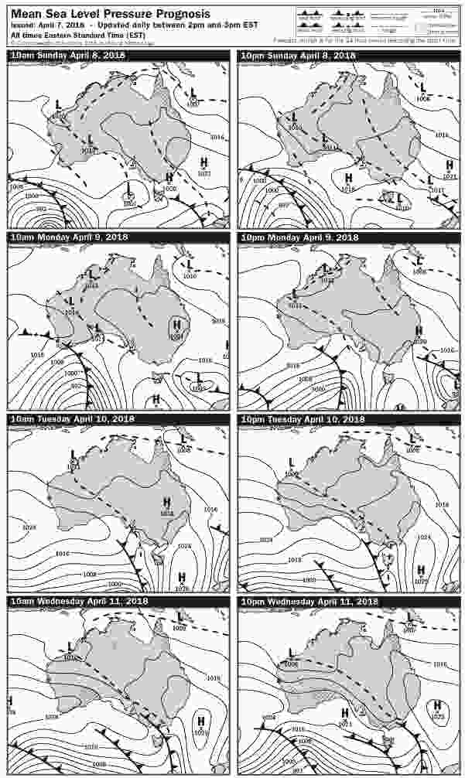
Leg 2 – Nelson to Eden
See Gribs:
8:30pm
07/4/2018
Front & low expected midnight Mon 9th
Adjust Sun/Mon headings
Nelson to Eden after a further 2 days
Synoptic Outlook
Weather Predictions and Passage Routing

Slide 45
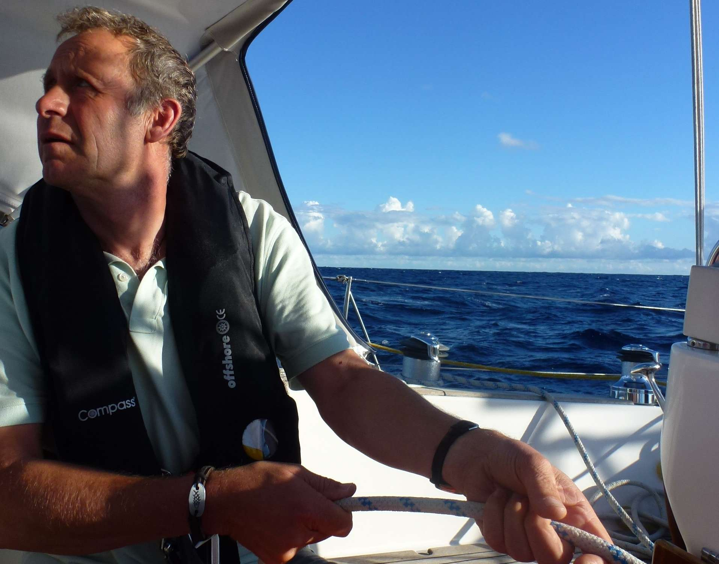
Leg 2 –Nelson to Eden

Slide 46
Leg 2 – Nelson to Eden
See Gribs:
10:00pm
08/4/2018
Front expected after midnight Mon 9th

Slide 47

Leg 2 – Nelson to Eden
See Gribs:
10:00pm
08/4/2018
Front expected after midnight Mon 9th
Adjust heading around passing of front Mon/Tue
Second Route Change
Nelson to Eden

Slide 48
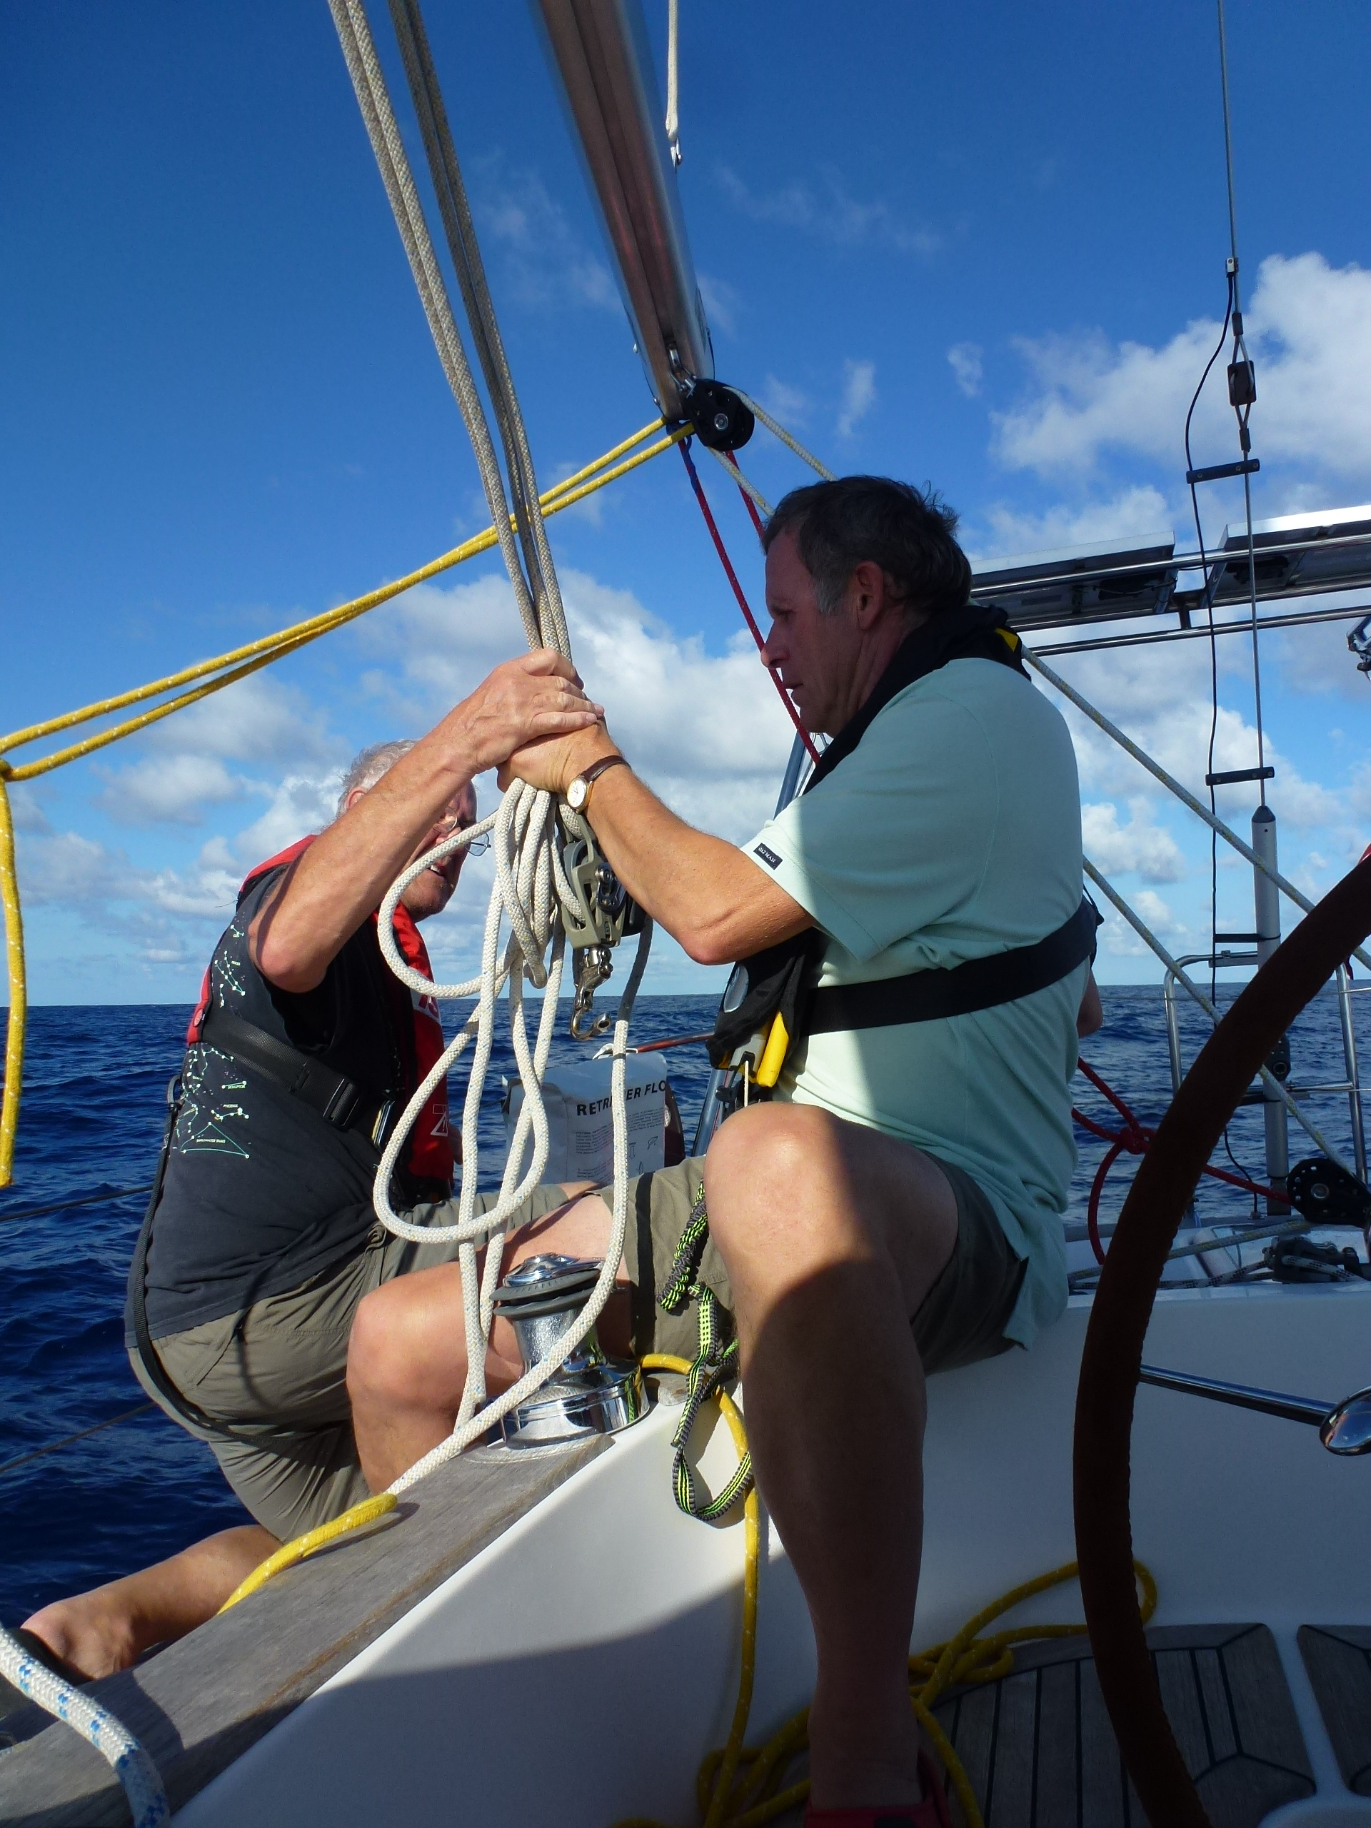
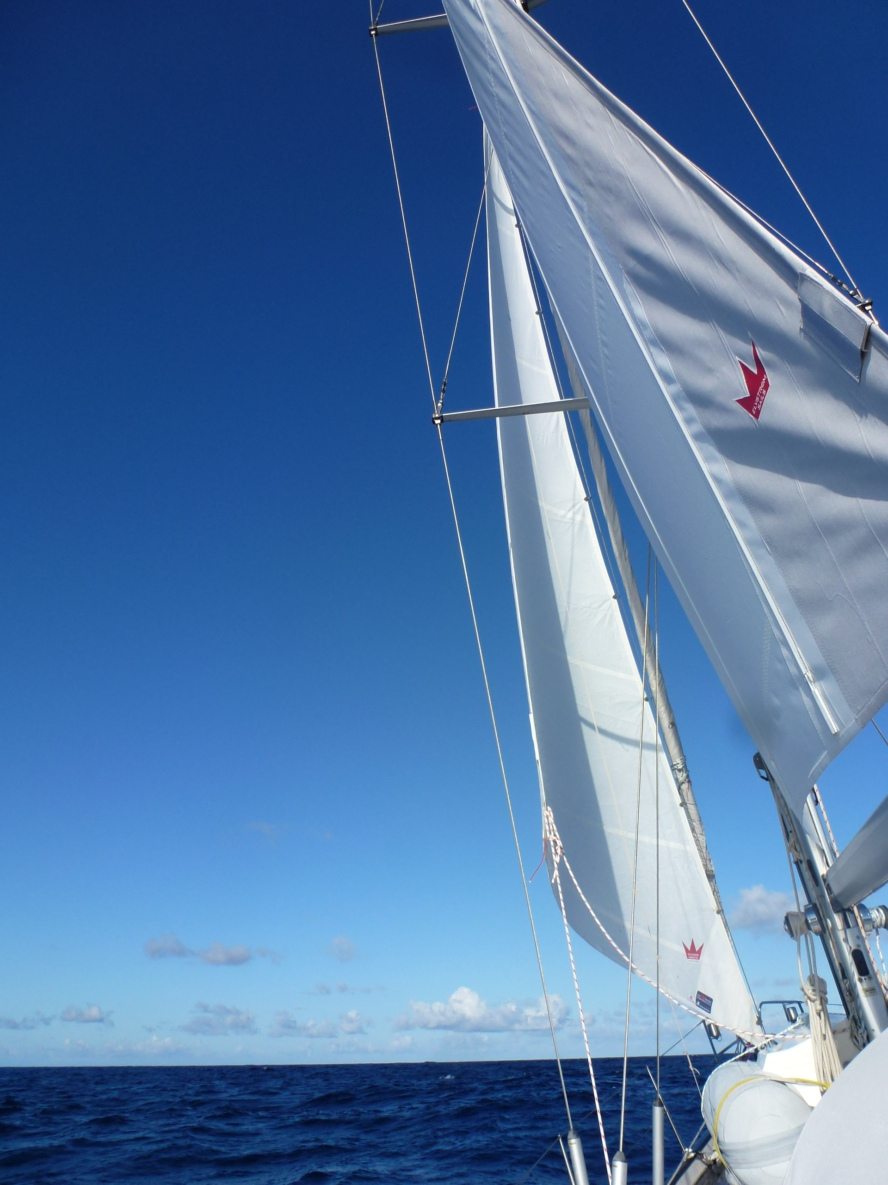
Leg 2 – Setting runners and hoisting the storm jib
Rusalka sloop rig with removable inner forestay and running back stays.
Sunday 8th: Set the backstay runners.
Monday 9th: Hoist the storm jib.
Weather Predictions and Passage Routing

Slide 49
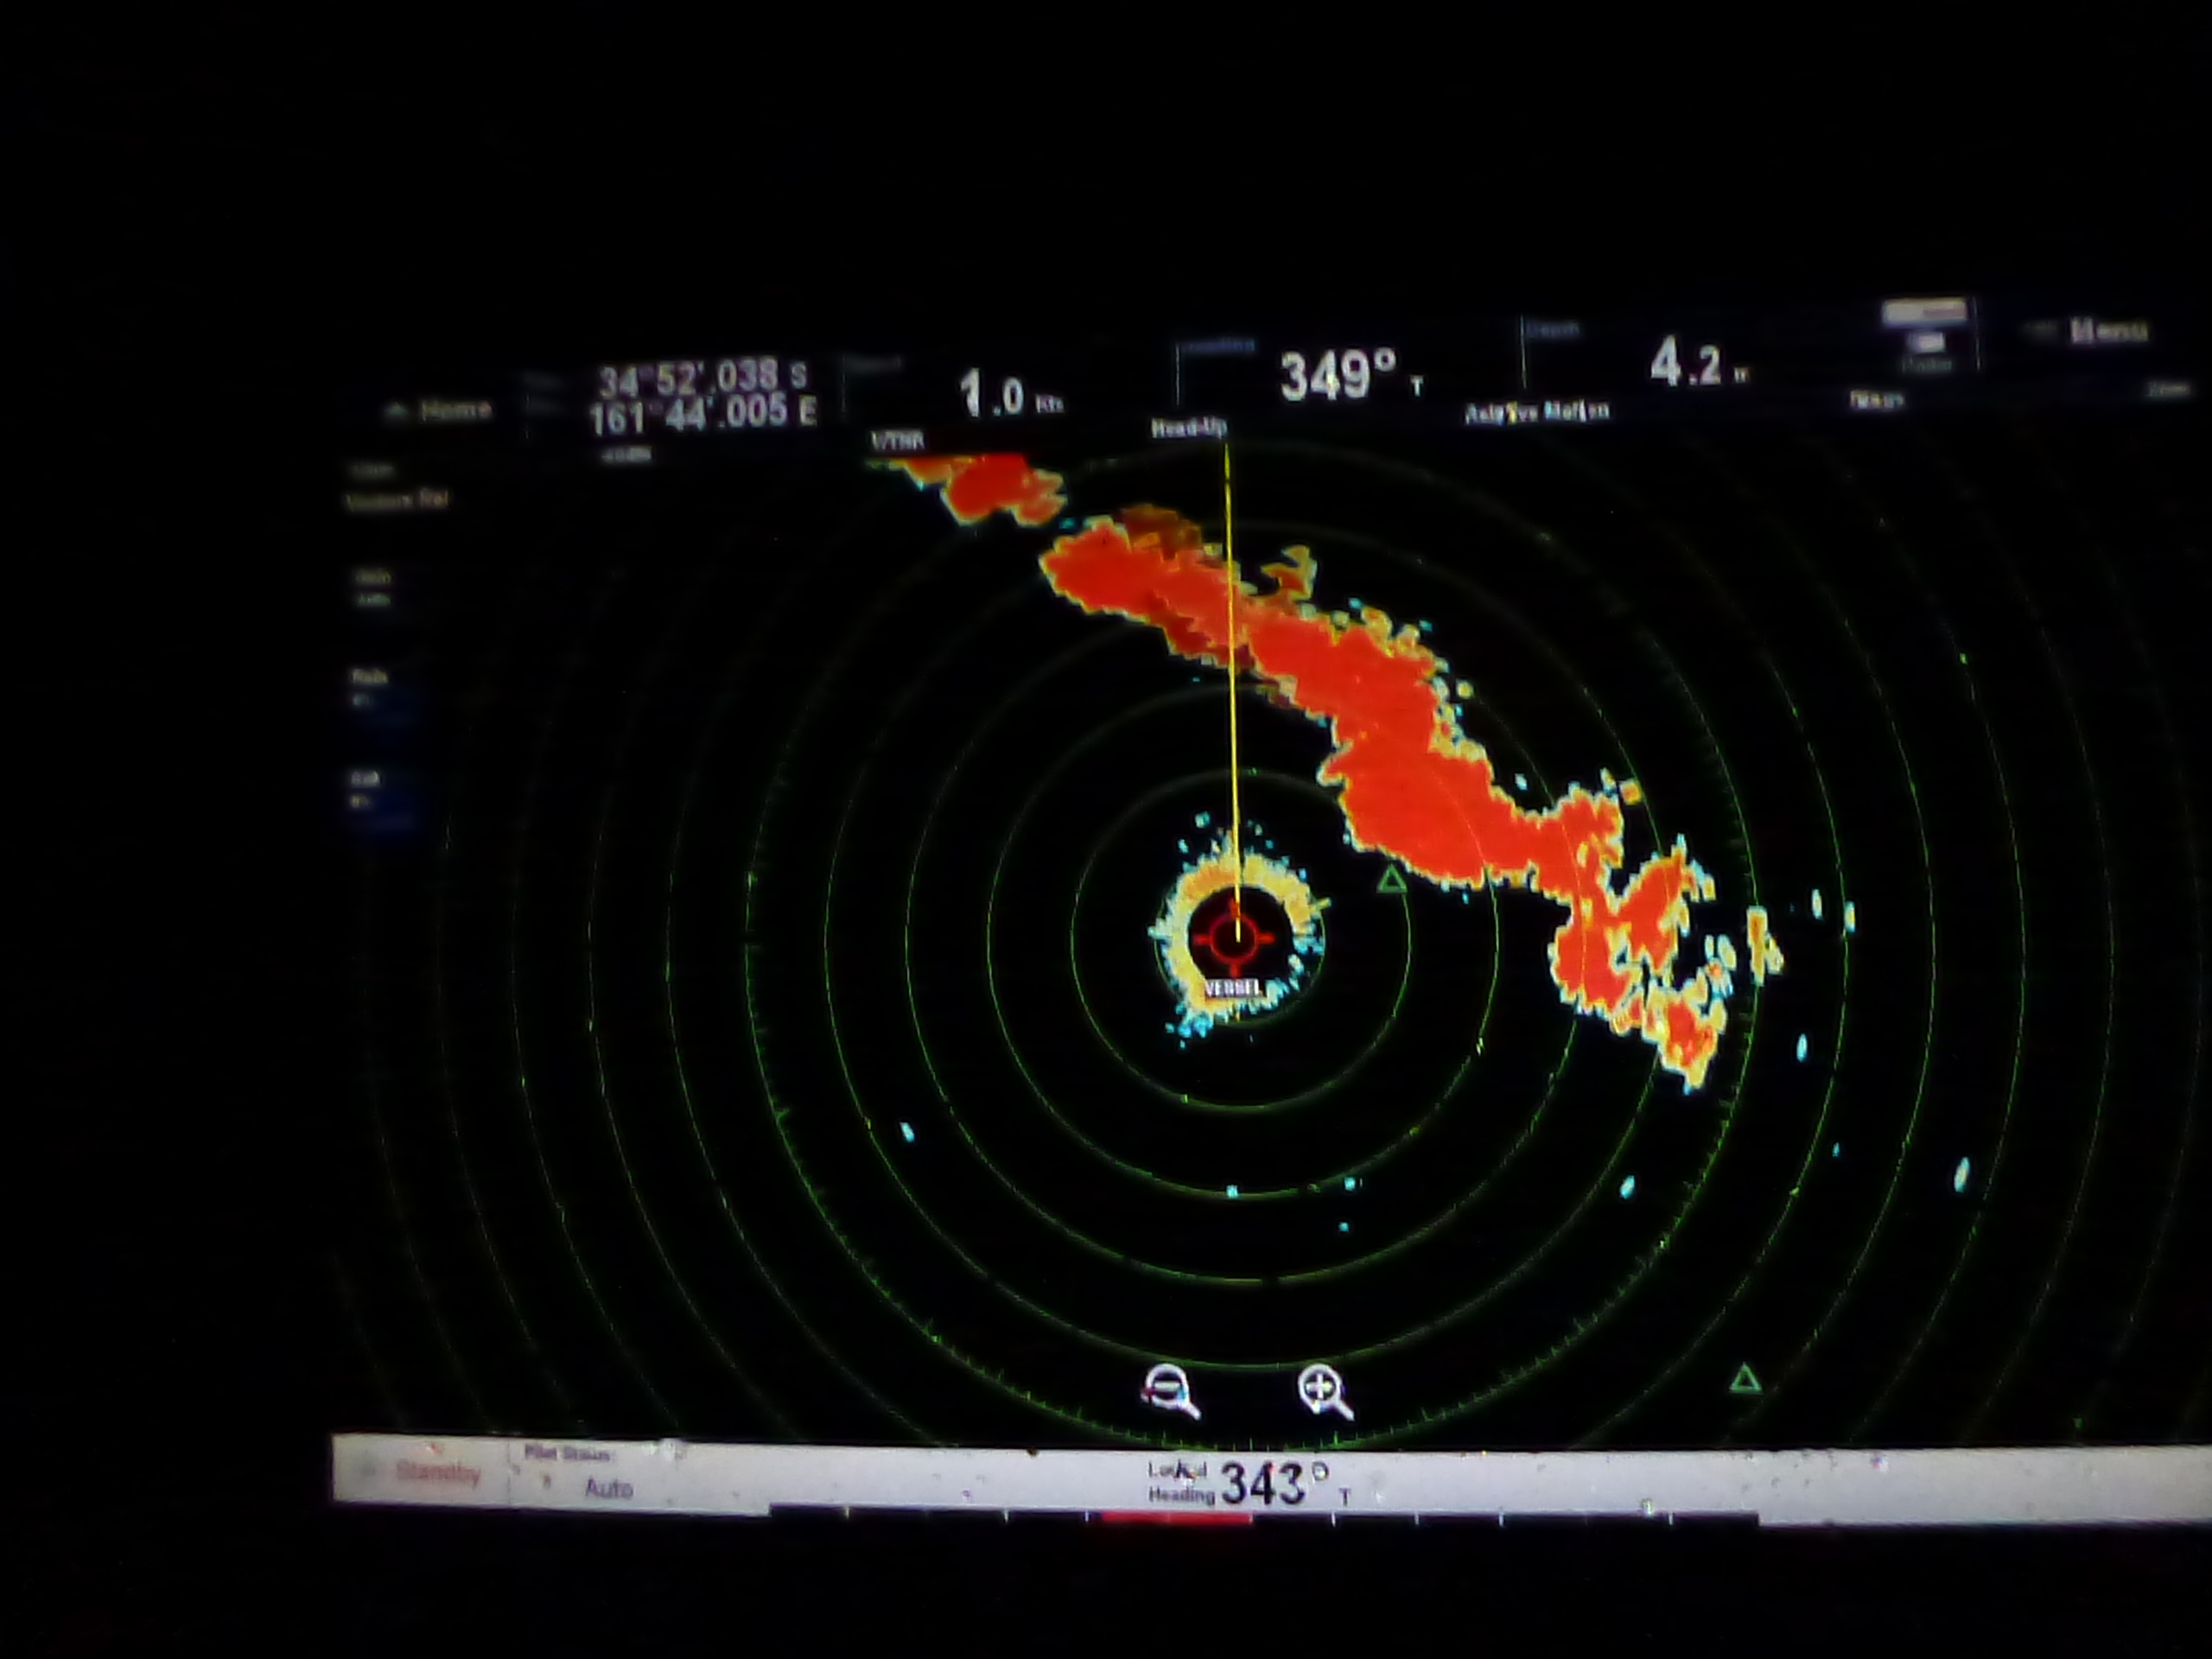
Leg 2 – Front passed over us
See Gribs:
09:30pm
10/4/2018
Front passed just after midnight Mon 9th
Weather Predictions and Passage Routing

Slide 50
Leg 2 – After the front
Exhausted
Hove to and all crew crashed into bunks
Too tired to take photos so there’s nothing to see
Weather Predictions and Passage Routing

Slide 51
Leg 2 – After the front
After the badly needed rest consider the situation
Weather Predictions and Passage Routing

Slide 52
Leg 2 – Nelson to Eden
See Gribs:
08:55am
10/4/2018
Small front expected Thu 12th
Nasty front expected Sat 14th off Eden

Slide 53
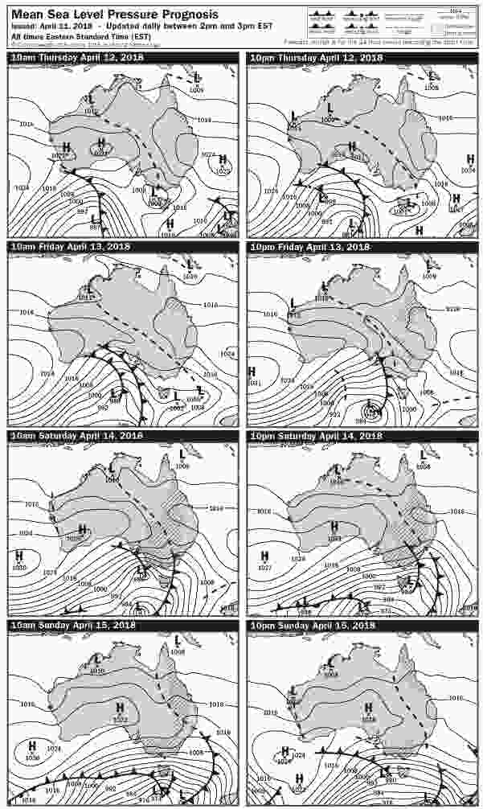
Leg 2 – Nelson to Newcastle
Forecast around Eden
Weather Predictions and Passage Routing

Slide 54
Leg 2 – After the front
Wind does not abate
Seas continue to build up
Course no further west than 325°T
Again consider Sydney or Newcastle
Outlook from Bob McDavitt…
Hi there Alex.
That front went thru North Island this morning with lots of squalls and lightning, two (known) tornadoes.
Yes these are huge swells, I was hoping they would be far apart enough to be gentle giants,
but in these strong winds the top 2metres are breaking waves,
and so be it, 325True.
We can possibly turn left to the SW again on Wednesday morning,
but that'd get us in difficult from strong adverse currents,/choppy seas
And so this suggests landfall at NEWCASTLE
If we went further SW along the coast then will encounter a strong SW change Sat night/Sunday.
SO here's update table to Newcastle. Usual decode , and in NZST , subtract 2 hours to get Aus time.
LT - HH:MM| Lat:/ Long :| hPa |lull~avg~gust|Brg-Kt |TWA|DRIFT to|Sig m
10-Apr-12:00|34:40S/161:20E|1017|-S-20~25~37|326-05.9|161|275-1.7|4.1
10-Apr-16:42|34:15S/160:59E|1018|-S-20~26~38|326-05.9|161|249-0.5|4.3
10-Apr-21:56|33:50S/160:40E|1021|SSE19~24~36|326-06.0|179|229-0.6|4.4
Weather Predictions and Passage Routing

Slide 55

Leg 2 – Nelson to Newcastle
Third Route Change
Nelson to Newcastle
Weather Predictions and Passage Routing

Slide 56
Leg 2 – Nelson to Eden
See Gribs:
08:55am
10/4/2018
Small front expected Thu 12th
Nasty front expected Sat 14th off Eden

Slide 57

Leg 2 – Nelson to Newcastle
Third Route Change
Nelson to Newcastle

Slide 58
Leg 2 – Nelson to Newcastle, heading 325T
Video removed, see youtube:
https://youtu.be/zsVFa3RZQl0
Weather Predictions and Passage Routing

Slide 59
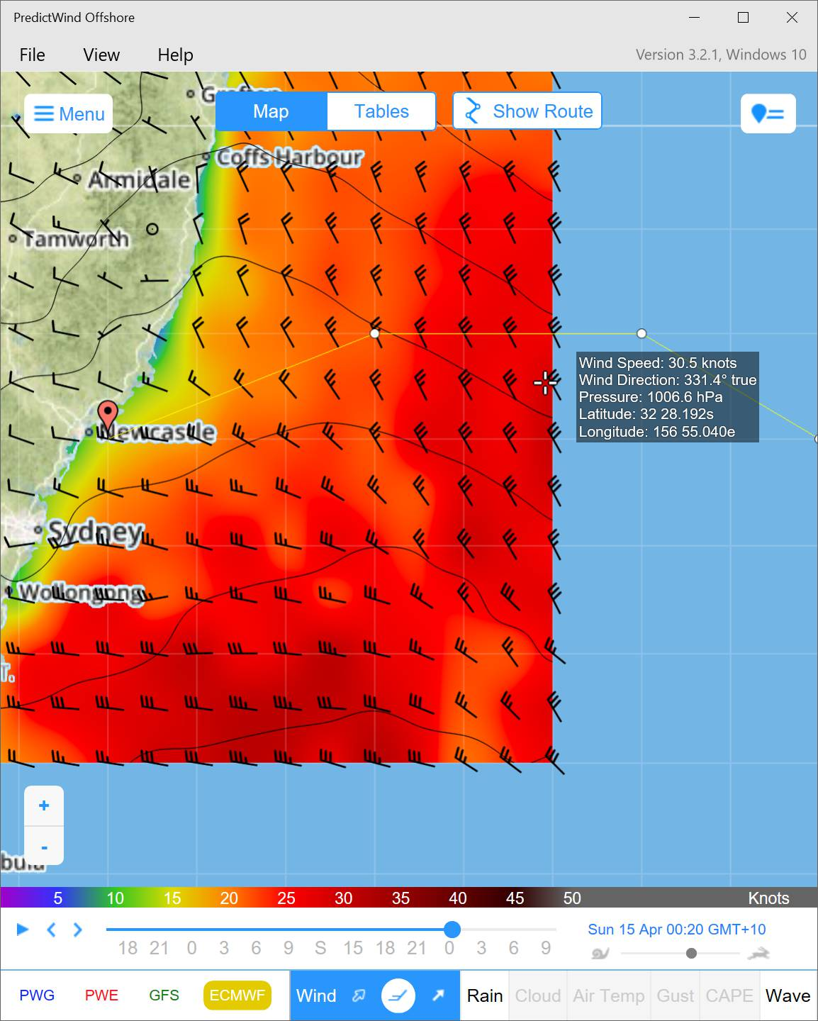
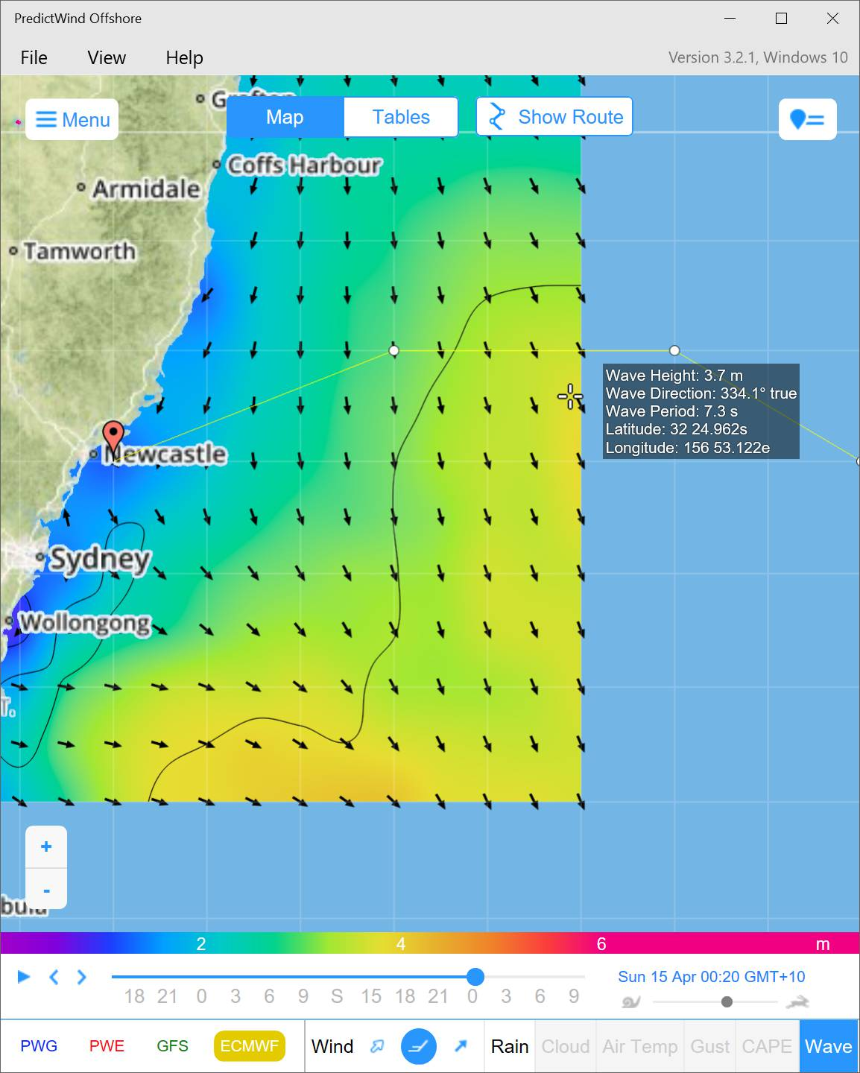
Leg 2 – Nelson to Newcastle, hove to
Second
hove to here
Weather Predictions and Passage Routing

Slide 60
Leg 2 – Nelson to Newcastle, hove to
Video removed, see youtube:
https://youtu.be/yJebZcVgylk
Weather Predictions and Passage Routing

Slide 61
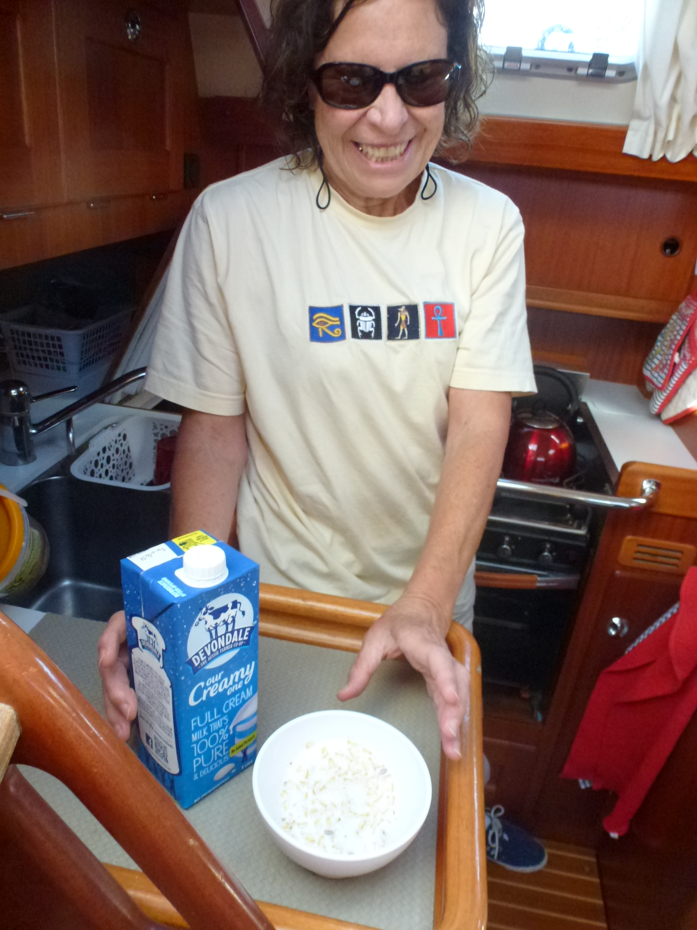
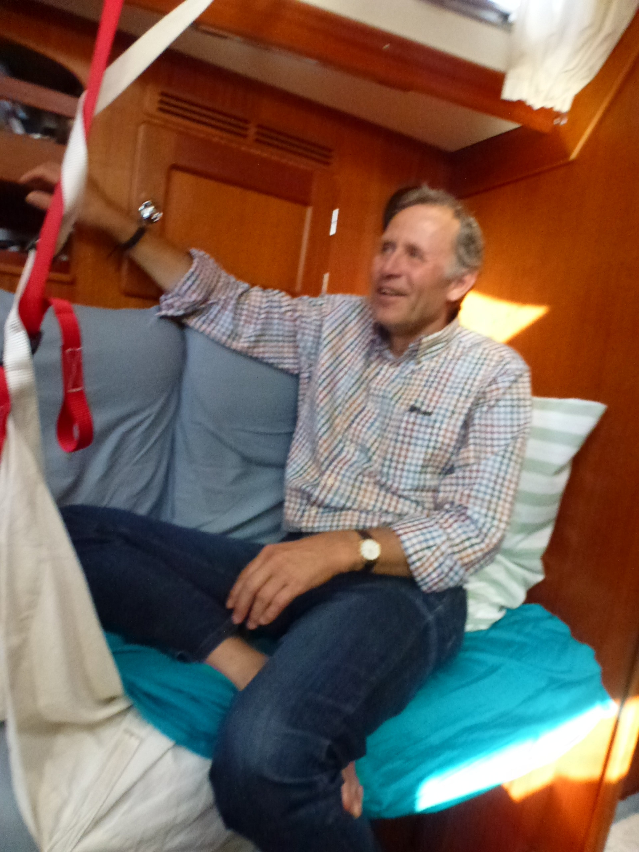
Leg 2 – Nelson to Newcastle, nearly there
After 5 hours rest while hoved to
Then got through the adverse current
Now running downwind assisted by very favourable current
Weather Predictions and Passage Routing

Slide 62
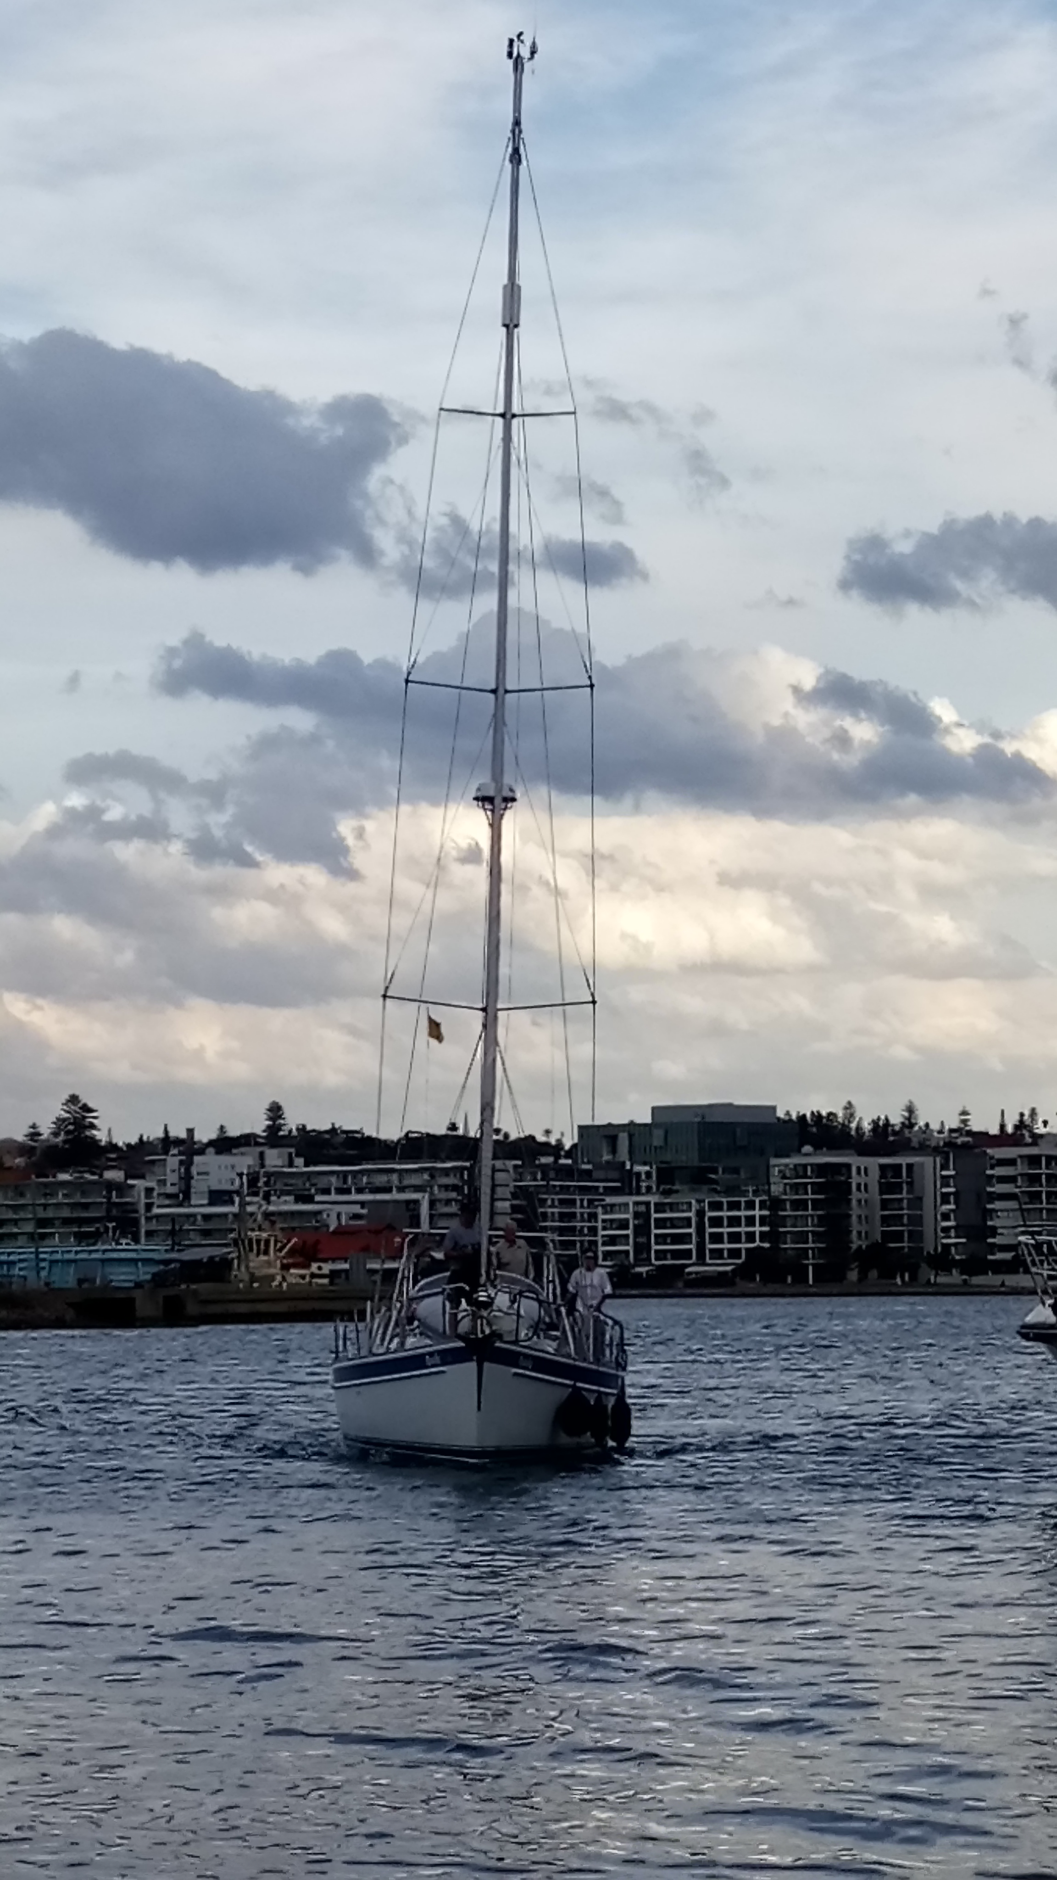
Leg 2 – Nelson to Newcastle
Arriving in Newcastle
(all in one piece)
Weather Predictions and Passage Routing

Slide 63
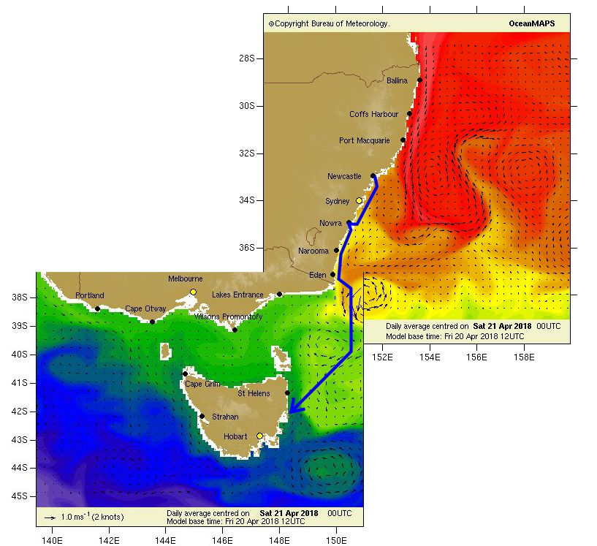
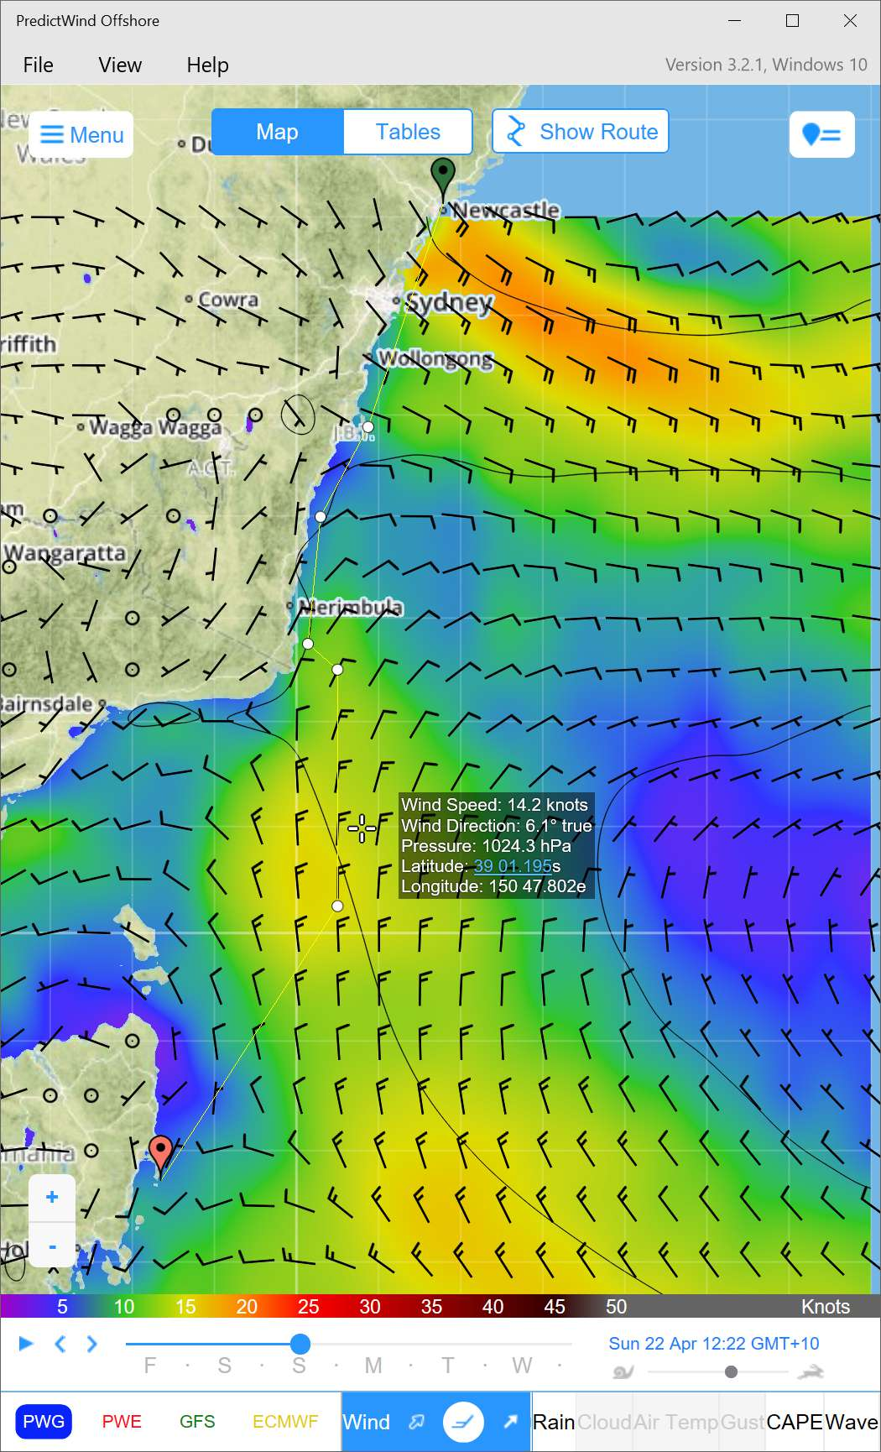
Leg 3 – Newcastle to Hobart
Light winds, from NW thru N to NE
Route determined mainly by currents
See Gribs:
07:30pm
17/4/2018
Weather Predictions and Passage Routing

Slide 64
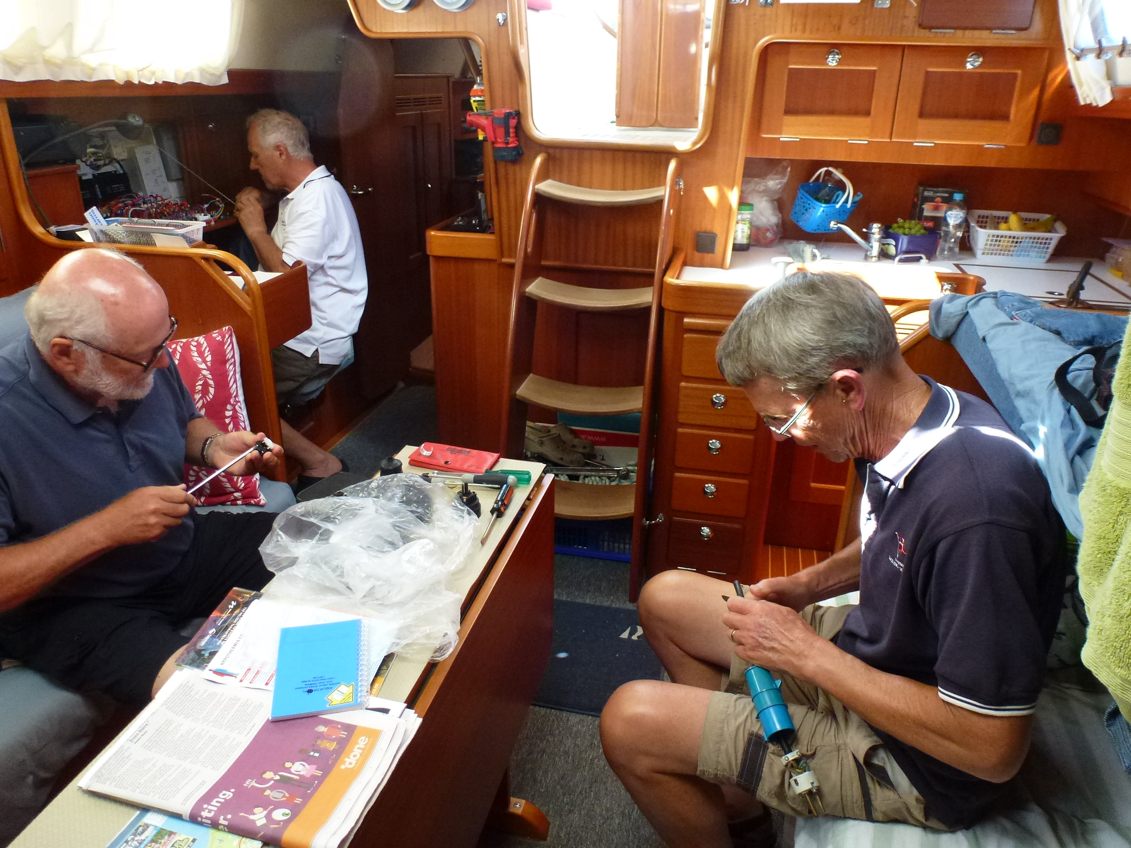
THANK YOU CREW
Leg 1
Hobart to Nelson
Andrew Boon
Bill De La Mare
Weather Predictions and Passage Routing

Slide 65
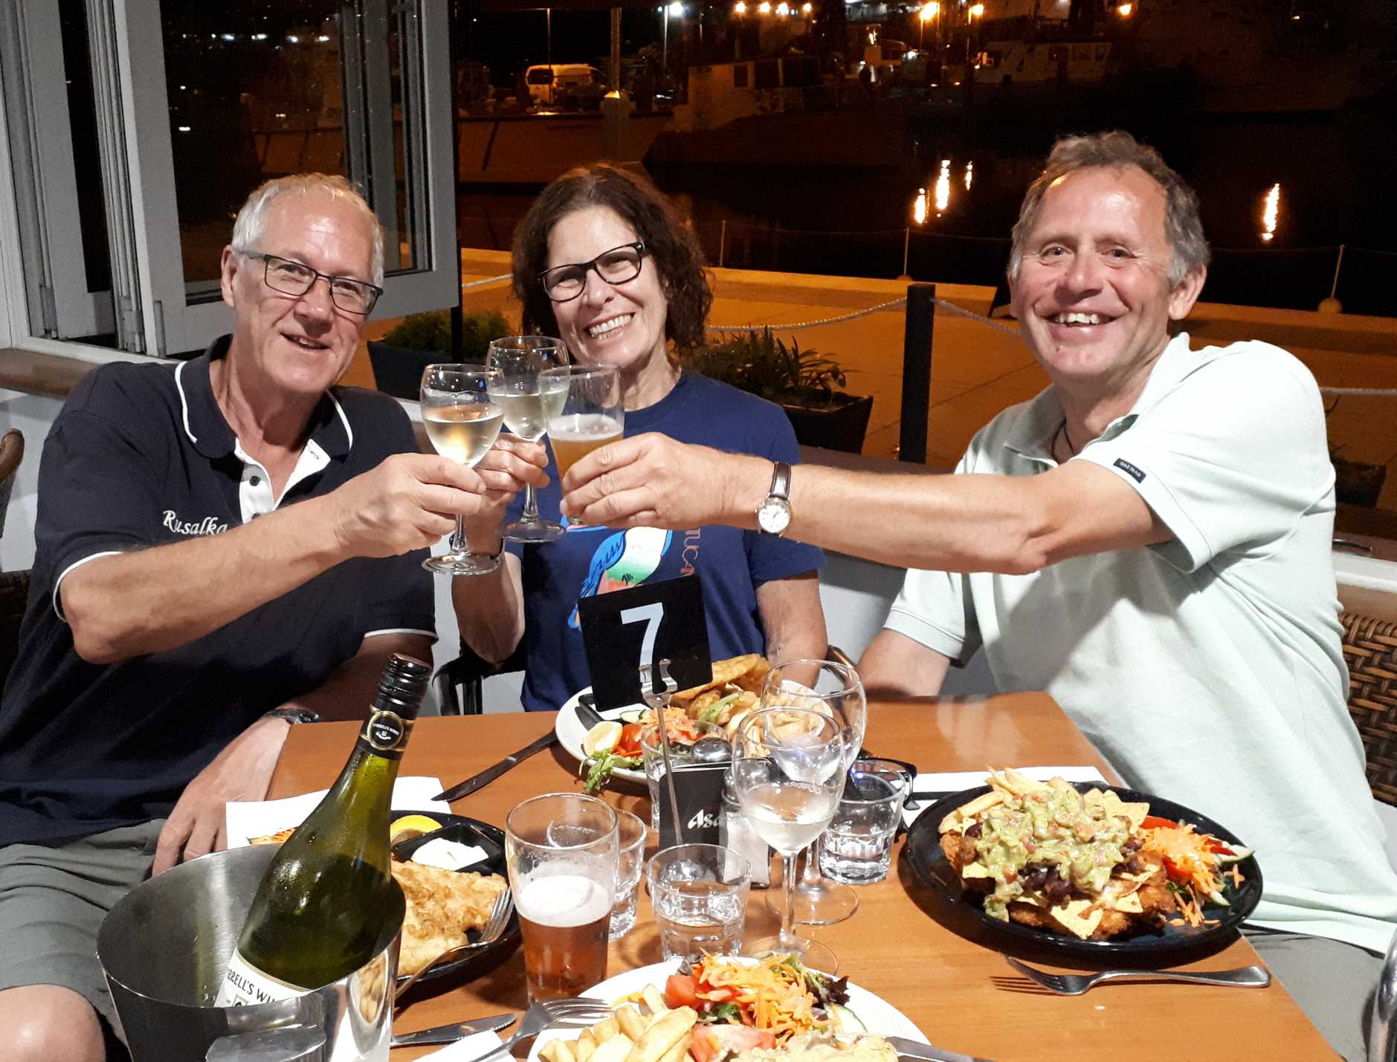
THANK YOU CREW
Leg 2
Nelson to Newcastle
(toughest leg)
Anne Wagner
David Mitchell
Weather Predictions and Passage Routing

Slide 66
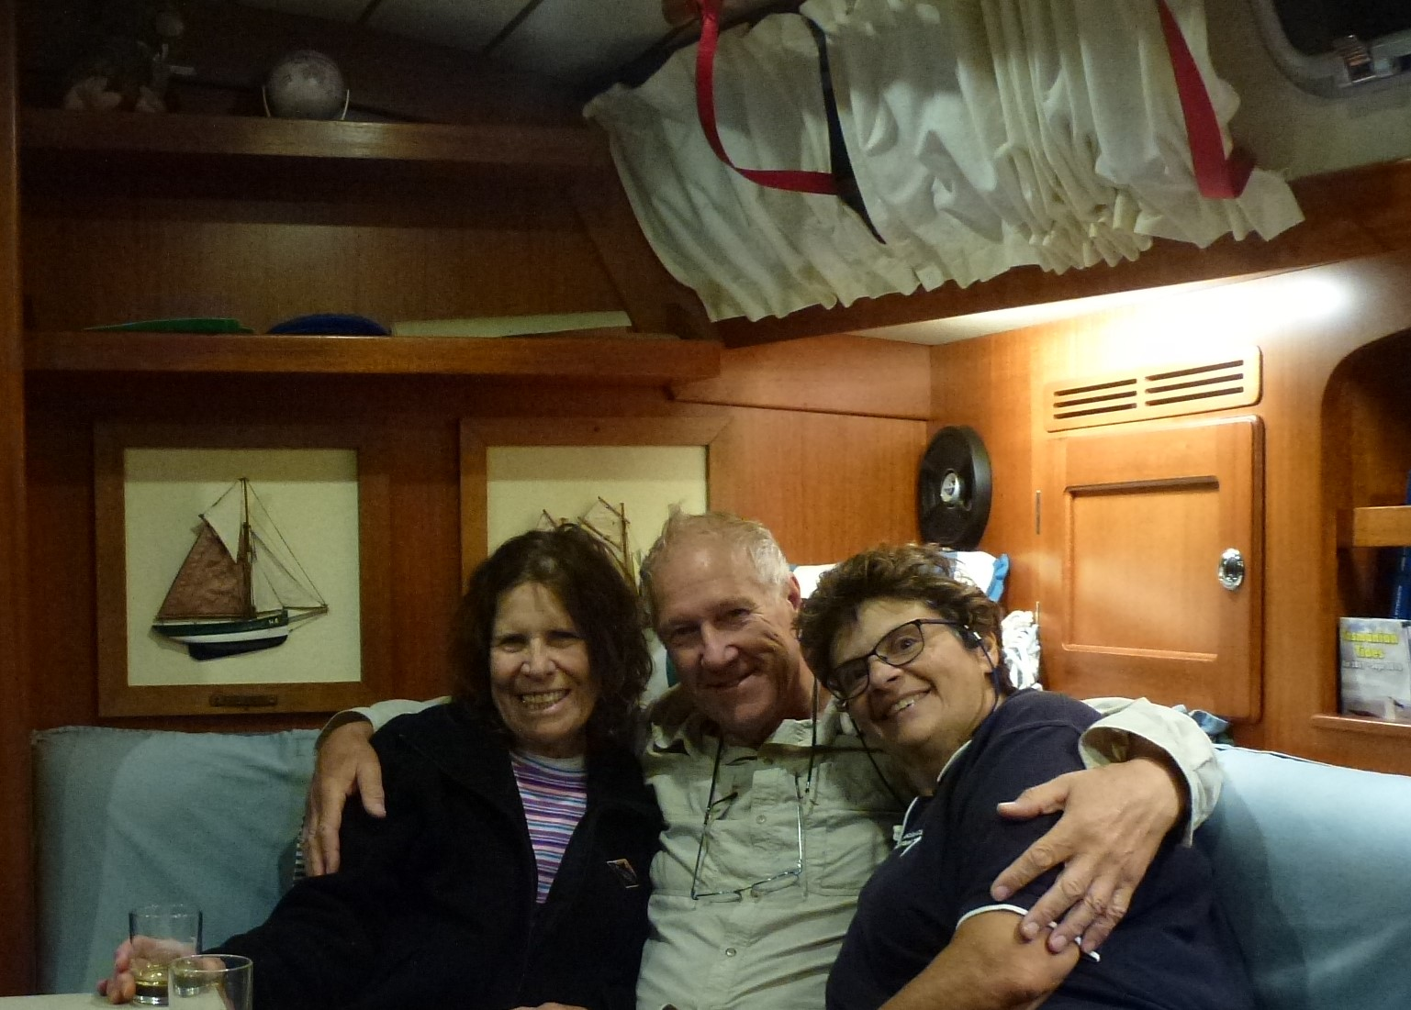
THANK YOU CREW
Leg 3
Newcastle to Hobart
Anne Wagner
Jackie
Weather Predictions and Passage Routing

